Slide 1
Traits of a Church that Heaven Applauds

Slide 2
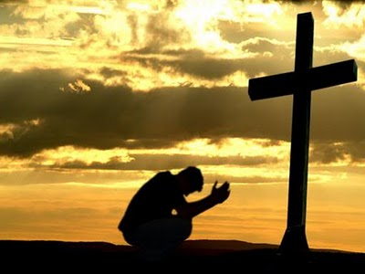
Irresistible Church
We do not want to make changes in order to attract more people, but rather, we want to make changes in order to attract the presence of God.
Our job is to keep ourselves postured for His grace.

Slide 3
^{THE} CHURCH OF THE BOOK OF ACTS
^{Chapter} 2
⁴²They devoted themselves to the apostles’ teaching and to fellowship, to the breaking of bread and to prayer. ⁴³ Everyone was filled with awe at the many wonders and signs performed by the apostles. ⁴⁴ All the believers were together and had everything in common. ⁴⁵ They sold property and possessions to give to anyone who had need. ⁴⁶ Every day they continued to meet together in the temple courts. They broke bread in their homes and ate together with glad and sincere hearts, ⁴⁷ praising God and enjoying the favor of all the people. And the Lord added to their number daily those who were being saved.

Slide 4
What Does an Irresistible Church Look Like?
You Grow Spiritually
You witness a sense of mission
You long to attend every week
You want to invest in this church in the long haul
You tell others about this church
You relax at this church knowing it’s a model of growth, not perfection
You are delightfully challenged at this church

Slide 5
What does a church need to get from point A to point B?
The will to change.
The Holy Spirit.

Slide 6
Trait 1- An Irresistible Church Hungers for the Presence of God
Having a greater realization for God’s Presence.
Longing to be filled to full measure with His Holy Spirit.
Includes a special anointing for a special task at a specific time

Slide 7
What can be done to make God’s presence more evident in churches?
Recognize if its lacking
Fruitless?
Wordless?
Careless?
Visionless?
Missionless?
Purposeless?

Slide 8
2. Work on it by syncing our hearts with heaven.
Incorporate a spiritual rule to our daily routine.

Slide 9
Acts 10:9-13 ⁹ The next day, as they went on their journey and drew near the city, Peter went up on the housetop to pray, about the sixth hour. ¹⁰ Then he became very hungry and wanted to eat; but while they made ready, he fell into a trance ¹¹ and saw heaven opened and an object like a great sheet bound at the four corners, descending to him and let down to the earth. ¹² In it were all kinds of four-footed animals of the earth, wild beasts, creeping things, and birds of the air. ¹³ And a voice came to him, “Rise, Peter; kill and eat.”

