Slide 1
Salvation through Baptism

Slide 2
Mark 16:15-16
“And He said to them, “Go into all the world and preach the gospel to every creature. ¹⁶ He who believes and is baptized will be saved; but he who does not believe will be condemned.”

Slide 3
What does it mean to be saved?
It means to be saved from the judgment of the world

Slide 4
James 4:4
“Adulterers and adulteresses! Do you not know that friendship with the world is enmity with God? Whoever therefore wants to be a friend of the world makes himself an enemy of God.”

Slide 5
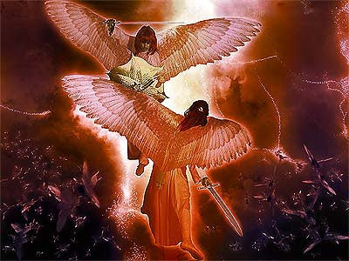
The battle of 2 worlds

Slide 6
1 Peter 3:18-21
“ For Christ also suffered once for sins, the just for the unjust, that He might bring us to God, being put to death in the flesh but made alive by the Spirit, ¹⁹ by whom also He went and preached to the spirits in prison, ²⁰ who formerly were disobedient, when once the Divine longsuffering waited in the days of Noah, while the ark was being prepared, in which a few, that is, eight souls, were saved through water.

Slide 7
1 Peter 3:18-21
²¹ There is also an antitype which now saves us—baptism (not the removal of the filth of the flesh, but the answer of a good conscience toward God), through the resurrection of Jesus Christ,”

Slide 8
Genesis 6: 5-7
“ Then the Lord saw that the wickedness of man was great in the earth, and that every intent of the thoughts of his heart was only evil continually. 6 And the Lord was sorry that He had made man on the earth, and He was grieved in His heart. 7 So the Lord said, “I will destroy man whom I have created from the face of the earth, both man and beast, creeping thing and birds of the air, for I am sorry that I have made them.”

Slide 9
Genesis 7:17-19
“Now the flood was on the earth forty days. The waters increased and lifted up the ark, and it rose high above the earth. ¹⁸ The waters prevailed and greatly increased on the earth, and the ark moved about on the surface of the waters. ¹⁹ And the waters prevailed exceedingly on the earth, and all the high hills under the whole heaven were covered.”

Slide 10
John 12:31
“Now is the judgment of this world; now the ruler of this world will be cast out.”

Slide 11
Genesis 8:4
Then the ark rested in the seventh month, the seventeenth day of the month, on the mountains of Ararat.

Slide 12
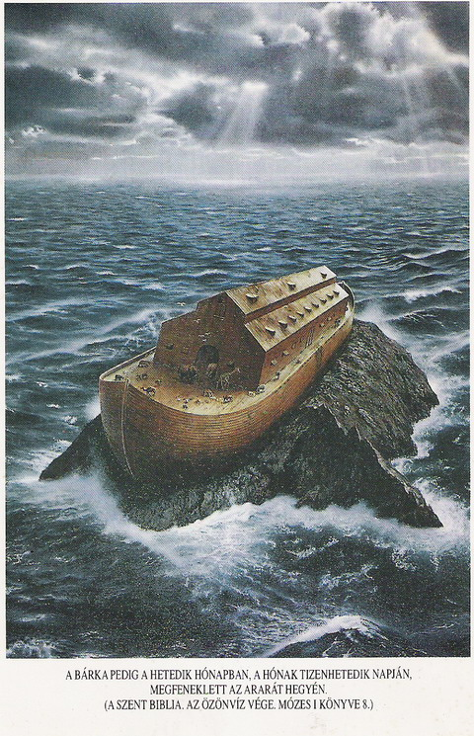
Ararat = “Holy ground”

Slide 13
Romans 6:3-4
Or do you not know that as many of us as were baptized into Christ Jesus were baptized into His death? ⁴ Therefore we were buried with Him through baptism into death, that just as Christ was raised from the dead by the glory of the Father, even so we also should walk in newness of life.
,

