Slide 1
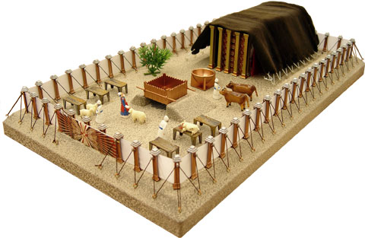
Build right
Youth Conference Nov. 2016

Slide 2
We are His House
4 For every house is built by someone, but He who built all things is God. 5 And Moses indeed was faithful in all His house as a servant, for a testimony of those things which would be spoken afterward, 6 but Christ as a Son over His own house, whose house we are if we hold fast the confidence and the rejoicing of the hope firm to the end. Heb 3:4-6

Slide 3
Points to be covered
A Story
It Starts with Synergy
He is the designer
He builds from inside out
He is building you while you are rebellious
He knows my weakness
He is designing even the workers
7. What is going on now and what are we waiting for ?

Slide 4
Doctor’s warning
You," said the doctor to the patient, "are in terrible shape. You've got to do something about it. First, tell your wife to cook more nutritious meals. Stop working like a dog. Also, inform your wife you're going to make a budget, and she has to stick to it. And have her keep the kids off your back so you can relax. Unless there are some changes like that in your life, you'll probably be dead in a month.”

Slide 5
Doctor’s warning
"Doc," the patient said, "this would sound more official coming from you. Could you please call my wife and give her those instructions?”
When the fellow got home, his wife rushed to him. "I talked to your doctor,"
she wailed. "Poor man, you've only got thirty days to live."

Slide 6
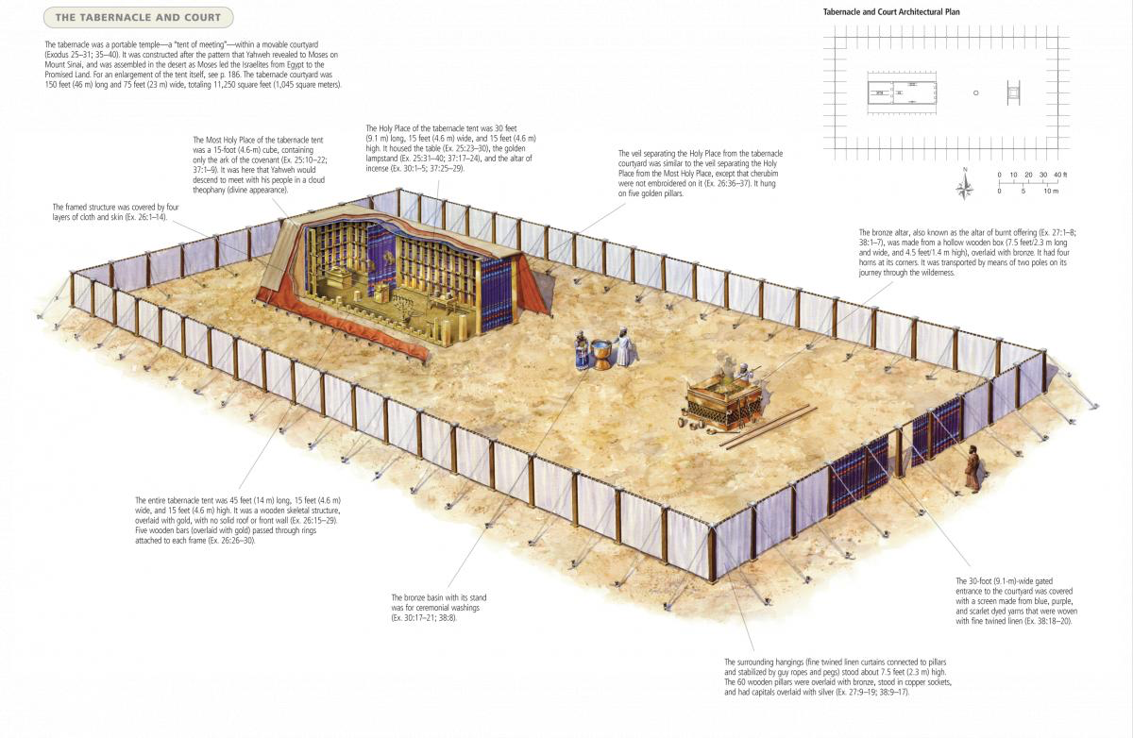
The Tabernacle

Slide 7
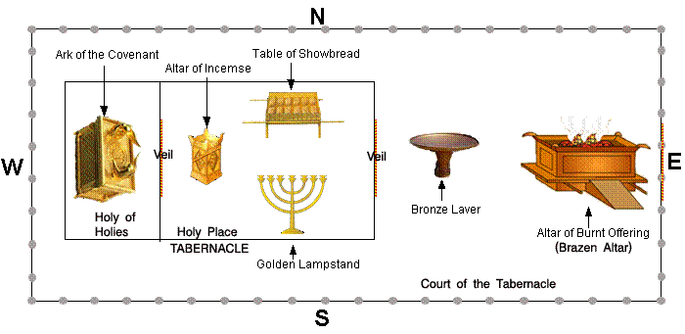
The Tabernacle

Slide 8
1. It Starts with Synergy
Then the Lord spoke to Moses, saying: “Speak to the children of Israel, that they bring Me an offering. From everyone who gives it willingly with his heart you shall take My offering. Ex 25:1,2

Slide 9
Gave themselves first to the Lord
Moreover, brethren, we make known to you the grace of God bestowed on the churches of Macedonia: 2 that in a great trial of affliction the abundance of their joy and their deep poverty abounded in the riches of their liberality. 3 For I bear witness that according to their ability, yes, and beyond their ability, they were freely willing, 4 imploring us with much urgency that we would receive the gift and the fellowship of the ministering to the saints. 5 And not only as we had hoped, but they first gave themselves to the Lord, and then to us by the will of God. 2 Cor 8:1-5

Slide 10
2. He is the designer
8 And let them make Me a sanctuary, that I may dwell among them. 9 According to all that I show you, that is, the pattern of the tabernacle and the pattern of all its furnishings, just so you shall make it. Ex 25:8,9

Slide 11
3. From inside out
“And they shall make an ark of acacia wood; two and a half cubits shall be its length, a cubit and a half its width, and a cubit and a half its height. …. “You shall make a mercy seat of pure gold; two and a half cubits shall be its length and a cubit and a half its width. Ex 25:17

Slide 12
Christ may dwell in your hearts
16 that He would grant you, according to the riches of His glory, to be strengthened with might through His Spirit in the inner man, 17 that Christ may dwell in your hearts through faith; that you, being rooted and grounded in love, Eph 3:16,17

Slide 13
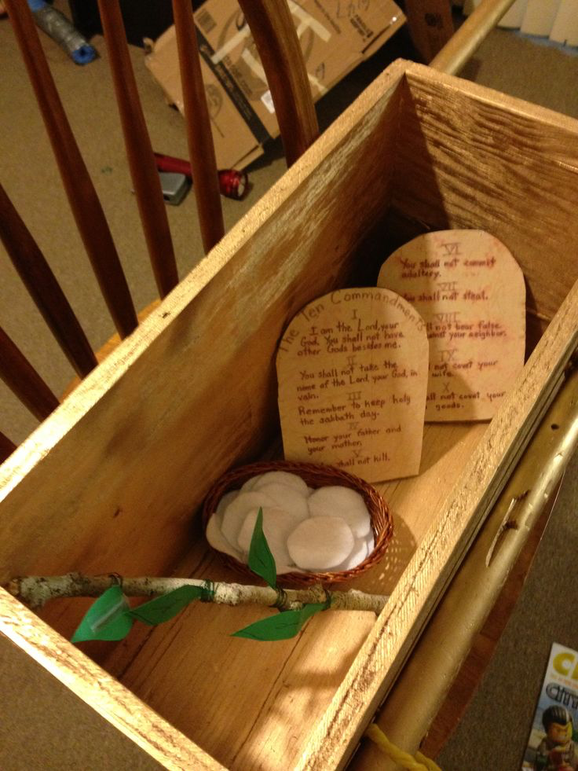
4. He is building you while you are rebellious
THE THREE MOST DISGRACEFUL EVENTS IN THE HISTORY OF ISRAEL

Slide 14
The Manna
“This is what the Lord has commanded: ‘Take an omer [portion for one man] of manna and keep it for the generations to come, so they can see the bread I gave you to eat in the desert when I brought you out of Egypt.’” (Exodus 16:32)

Slide 15
The Staff
“And the Lord said to Moses, ‘Put back the staff of Aaron before the testimony, to be kept as a sign for the rebels, that you may make an end of their grumblings against me, lest they die.’” (Numbers 17:10)

Slide 16
The two tablets
“Now if you obey me fully and keep my covenant, then out of all nations you will be my treasured possession. Although the whole earth is mine, you will be for me a kingdom of priests and a holy nation.” (Exodus 19:5-6)

Slide 17
Frist two tablets
15 And Moses turned and went down from the mountain, and the two tablets of the Testimony were in his hand. The tablets were written on both sides; on the one side and on the other they were written. 16 Now the tablets were the work of God, and the writing was the writing of God engraved on the tablets. Ex 32:15,16

Slide 18
Second two tablets
And the Lord said to Moses, “Cut two tablets of stone like the first ones, and I will write on these tablets the words that were on the first tablets which you broke. Ex 34:1

Slide 19
Sunday Theotokia (13)
A true tabernacle, is Mary the Virgin, placed in its midst, the true testimonies.
The undefiled ark, overlaid roundabout with gold, and the mercy seat, of the Cherubim.
The golden vessel, where the manna was hidden, behold the Word of the Father, came and took flesh from you.
The golden lampstand, carrying the true Light, who is the unapproachable, Light of the world.

Slide 20
(ἱλαστήριον)
17 “You shall make a mercy seat (ἱλαστήριον) of pure gold; two and a half cubits shall be its length and a cubit and a half its width. Ex 25:17

Slide 21
5. He knows my weakness
15 “Then he shall kill the goat of the sin offering, which is for the people, bring its blood inside the veil, do with that blood as he did with the blood of the bull, and sprinkle it on the mercy seat and before the mercy seat. 16 So he shall make atonement for the Holy Place, because of the uncleanness of the children of Israel, and because of their transgressions, for all their sins; and so he shall do for the tabernacle of meeting which remains among them in the midst of their uncleanness. Lev 16:15,16

Slide 22
Sunday Theotokia (Part 3)
The mercy seat, was overshadowed by, the forged Cherubim, from all sides.
Was a symbol of God the Word, who was incarnate, of you without change, O undefiled.
He became the purification, of our sins, and the forgiveness, of our iniquities.

Slide 23
6. He puts me in a New place
29 “So Aaron shall bear the names of the sons of Israel on the breastplate of judgment over his heart, when he goes into the holy place, as a memorial before the Lord continually. 30 And you shall put in the breastplate of judgment the Urim and the Thummim, and they shall be over Aaron’s heart when he goes in before the Lord. So Aaron shall bear the judgment of the children of Israel over his heart before the Lord continually.

Slide 24
7. He is designing even the workers
Then the Lord spoke to Moses, saying: 2 “See, I have called by name Bezalel the son of Uri, the son of Hur, of the tribe of Judah. 3 And I have filled him with ¹ the Spirit of God, in ² wisdom, in ³ understanding, in ⁴ knowledge, and in ⁵ all manner of workmanship, 4 to design artistic works, to work in gold, in silver, in bronze, 5 in cutting jewels for setting, in carving wood, and to work in all manner of workmanship. EX 31:1-5

Slide 25
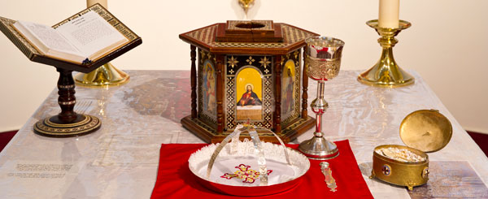
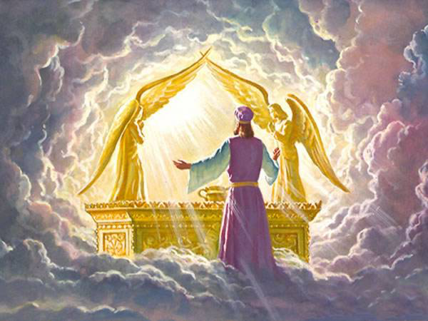
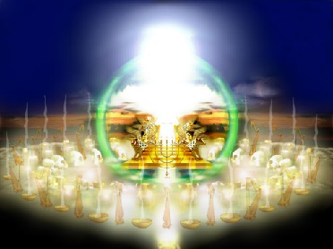
7. What is going on now and what are we waiting for ?

Slide 26
Tabernacled = σκηνόω
And the Word was made flesh, and tabernacled among us, (and we beheld his glory, the glory as of the only begotten of the Father,) full of grace and truth. Jn 1:14

Slide 27
St. Cyril of Alexandria
“Only if it is one and the same Christ who is consubstantial with the Father and with men can He save us, for the meeting ground between God and man is Flesh and Christ.”

Slide 28
The true tabernacle
A minister of the sanctuary, and of the true tabernacle, which the Lord pitched, and not man. Heb 8:2
23 It was therefore necessary that the patterns of things in the heavens should be purified with these; but the heavenly things themselves with better sacrifices than these. For Christ is not entered into the holy places made with hands, which are the figures of the true; but into heaven itself, now to appear in the presence of God for us: Heb 9:23,24

Slide 29
St Cyril the great
This expression, however, ‘the Word was made flesh’ [John 1:14], can mean nothing else but that he partook of flesh and blood like to us; he made our body his own, and came forth man from a woman, not casting off his existence as God, or his generation of God the Father, but even in taking to himself flesh remaining what he was.

Slide 30
The heavenly Tabernacle
And I heard a great voice out of heaven saying, Behold, the tabernacle of God is with men, and he will dwell with them, and they shall be his people, and God himself shall be with them, and be their God. Rev 21:3

Slide 31
St. Athanasius of Alexandria
“O noble Virgin, truly you are greater than any other greatness. For who is your equal in greatness, O dwelling place of God the Word? To whom among all creatures shall I compare you, O Virgin? You are greater than them all O (Ark of the) Covenant, clothed with purity instead of gold! You are the Ark in which is found the golden vessel containing the true manna, that is, the flesh in which Divinity resides.” Homily of the Papyrus of Turin.

