Slide 1
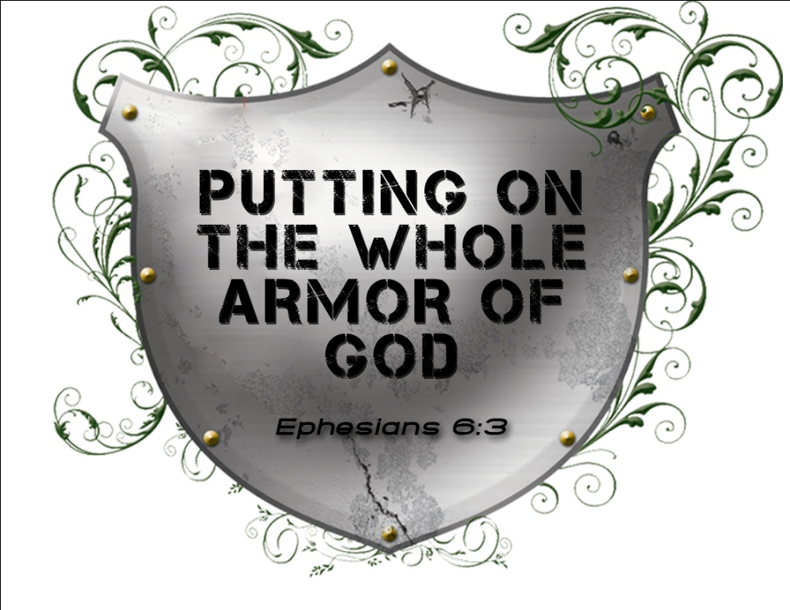
The Armor of Integrity
Spiritual Warfare – Part 5
March 14, 2010

Slide 2
“Therefore take up the whole armor of God, that you may be able to withstand in the evil day, and having done all, to stand. Stand therefore, having girded your waist with truth, having put on the breastplate of righteousness and having shod your feet with the preparation of the gospel of peace” Ephesians 6:13-15

Slide 3

“Be sober, be vigilant; because your adversary the devil walks about like a roaring lion, seeking whom he may devour.” 1 Peter 5:8

Slide 4
Take Up the WHOLE Armor of God

Slide 5
Take Up the WHOLE Armor of God
I must prepare when I am strong
in order to to resist when I am weak
“Therefore let him who thinks he stands take heed lest he fall.” 1 Corinthians 10:12

Slide 6
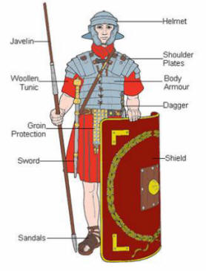
Belt of Truth
Breastplate of Righteousness

Slide 7
Belt of Truth
Breastplate of Righteousness
A Life of Integrity
“quality or state of being complete or undivided or incorruptible”

Slide 8
Why So Important

Slide 9
Why So Important
Life of integrity is a life of blessing
“The righteousness of the blameless will direct his way aright, but the wicked will fall by his own wickedness. The righteousness of the upright will deliver them, but the unfaithful will be caught by their lust.” Proverbs 11:5-6

Slide 10
Why So Important
Life of integrity is a life of blessing
“He who walks with integrity walks securely, but he who perverts his ways will become known.” Proverbs 10:9

Slide 11
Why So Important
Life of integrity is a life of blessing
Life lacking integrity is a target for invasion
“But let your ‘Yes’ be ‘Yes,’ and your ‘No,’ ‘No.’ For whatever is more than these is from the evil one.” Matthew 5:37

Slide 12
How to Live Life of Integrity

Slide 13
How to Live Life of Integrity
Belt of Truth: always speak the truth
“Lying lips are an abomination to the LORD, but those who deal truthfully are His delight.” Proverbs 12:22

Slide 14
How to Live Life of Integrity
Belt of Truth: always speak the truth
“that we…speaking the truth in love, may grow up in all things into Him who is the head—Christ” Ephesians 4:15

Slide 15
How to Live Life of Integrity
Belt of Truth: always speak the truth
“Put away from you a deceitful mouth, and put perverse lips far from you.” Proverbs 4:24

Slide 16
How to Live Life of Integrity
Breastplate of Righteousness:

Slide 17
How to Live Life of Integrity
Breastplate of Righteousness: stand up for what’s right
“In the way of righteousness is life, and in its pathway there is no death.” Proverbs 12:28

Slide 18
Solomon’s Lack of Integrity
“But King Solomon loved many foreign women, as well as the daughter of Pharaoh: women of the Moabites, Ammonites, Edomites, Sidonians, and Hittites — from the nations of whom the LORD had said to the children of Israel, “You shall not intermarry with them, nor they with you. Surely they will turn away your hearts after their gods.” Solomon clung to these in love.” 1 Kings 11:1-2

Slide 19
Solomon’s Lack of Integrity
“And he had seven hundred wives, princesses, and three hundred concubines; and his wives turned away his heart. For it was so, when Solomon was old, that his wives turned his heart after other gods; and his heart was not loyal to the LORD his God, as was the heart of his father David.” 1 Kings 11:3-4

Slide 20
How to Live Life of Integrity
Breastplate of Righteousness: stand up for what’s right
“The mouth of the righteous brings forth wisdom… The lips of the righteous know what is acceptable, but the mouth of the wicked what is perverse.” Proverbs 10:31-32

Slide 21
small holes sink BIG ships

Slide 22
small holes sink BIG ships
“that you may become blameless and harmless, children of God without fault in the midst of a crooked and perverse generation, among whom you shine as lights in the world” Philippians 2:15

