Slide 1

It’s All in the Shoes
Spiritual Warfare – Part 4
March 7, 2010

Slide 2
Most Important Piece of Gear?

Slide 3
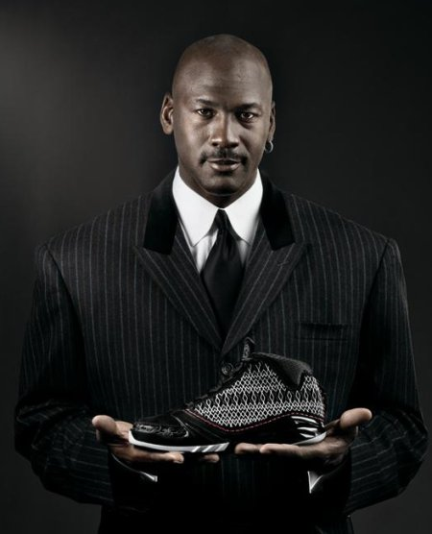
Most Important Piece of Gear?
It’s gotta be the shoes!
“Stand therefore…having shod your feet with the preparation of the gospel of peace” Ephesians 6:15

Slide 4
The primary purpose of shoes is to protect from defilement and harm

Slide 5
The primary purpose of shoes is to protect from defilement and harm
The #1 cause of defilement/injury today is SEXUAL IMMORALITY

Slide 6
“For this is the will of God, your sanctification: that you should abstain from sexual immorality; that each of you should know how to possess his own vessel in sanctification and honor, not in passion of lust, like the Gentiles who do not know God… For God did not call us to uncleanness, but in holiness.” 1 Thessalonians 4:3-7

Slide 7
Sexual immorality is any sexual gratification outside of marriage
“For this is the will of God, your sanctification: that you should abstain from sexual immorality; that each of you should know how to possess his own vessel in sanctification and honor, not in passion of lust, like the Gentiles who do not know God… For God did not call us to uncleanness, but in holiness.” 1 Thessalonians 4:3-7

Slide 8
Protecting My Feet

Slide 9
Protecting My Feet
Commit to God’s standard
“But Daniel purposed in his heart that he would not defile himself with the portion of the king's delicacies, nor with the wine which he drank; therefore he requested of the chief of the eunuchs that he might not defile himself.” Daniel 1:8

Slide 10
Protecting My Feet
Commit to God’s standard
"How can [anyone] keep his way pure? By living according to Your Word." Psalm 119:9

Slide 11
Protecting My Feet
Commit to God’s standard
“So God created man in His own image; in the image of God He created him; male and female He created them.” Genesis 1:27

Slide 12
Protecting My Feet
Commit to God’s standard
“So God created man in His own image; in the image of God He created him; male and female He created them.” Genesis 1:27
Sexuality is POWERFUL

Slide 13
Protecting My Feet
Commit to God’s standard
“Flee sexual immorality. Every sin that a man does is outside the body, but he who commits sexual immorality sins against his own body.” 1 Corinthians 6:18

Slide 14
Protecting My Feet
Commit to God’s standard
“Flee sexual immorality. Every sin that a man does is outside the body, but he who commits sexual immorality sins against his own body.” 1 Corinthians 6:18
Sexual sins have life long consequences

Slide 15


Protecting My Feet
Control my EYES/THOUGHTS

Slide 16
Protecting My Feet
Control my EYES/THOUGHTS
“I have made a covenant with my eyes; Why then should I look upon a young woman?” Job 31:1

Slide 17
Protecting My Feet
Control my EYES/THOUGHTS
"The mouth of fools feeds on foolishness." Proverbs 15:14
Monitor your MEDIA INTAKE

Slide 18
Protecting My Feet
Flee when temptation FIRST ARISES
“Flee also youthful lusts…” 2 Timothy 2:22

Slide 19
Protecting My Feet
Flee when temptation FIRST ARISES
“So it was, as she spoke to Joseph day by day, that he did not heed her, to lie with her or to be with her. But it happened about this time, when Joseph went into the house to do his work, and none of the men of the house was inside, that she caught him by his garment, saying, Lie with me. But he left his garment in her hand, and fled and ran outside.” Genesis 39:10-12

Slide 20
Protecting My Feet
Flee when temptation FIRST ARISES
“No temptation has overtaken you except such as is common to man; but God is faithful, who will not allow you to be tempted beyond what you are able, but with the temptation will also make the way of escape, that you may be able to bear it.” 1 Corinthians 10:13
Study your own PATTERNS

Slide 21
Protecting My Feet
Magnify the CONSEQUENCES
"Whoever commits adultery with a woman lacks understanding; he who does so destroys his own soul” Proverbs 6:32

Slide 22
Protecting My Feet
Magnify the CONSEQUENCES
“The thief does not come except to steal, and to kill, and to destroy. I have come that they may have life, and that they may have it more abundantly.” John 10:10

Slide 23
Protecting My Feet
Magnify the CONSEQUENCES
“The thief does not come except to steal, and to kill, and to destroy. I have come that they may have life, and that they may have it more abundantly.” John 10:10
Sexual sins can RUIN YOUR LIFE

Slide 24
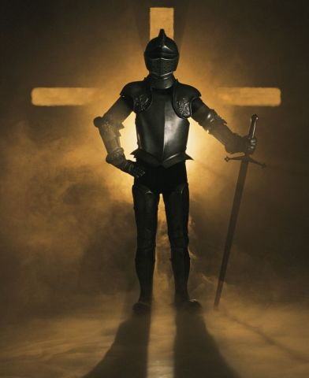
“Sir [Jesus], give me this water, that I may not thirst, nor come here to draw.”
John 4:15

