Slide 1
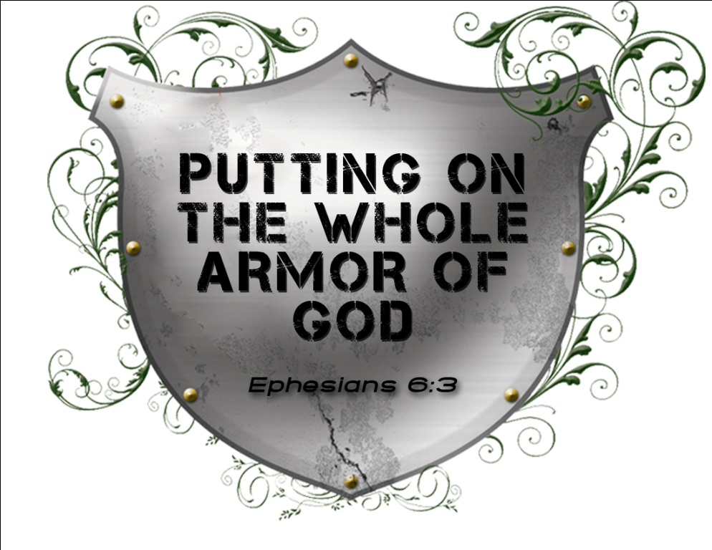
The War is On!
Spiritual Warfare – Part 1
February 14, 2010

Slide 2
What is Spiritual Warfare?
“There are two equal and opposite errors into which our race can fall about the devils. One is to disbelieve in their existence. The other is to believe, and to feel an excessive and unhealthy interest in them. They themselves are equally pleased by both errors and hail a materialist or a magician with the same delight.” C.S. Lewis

Slide 3
You are in an UNSEEN war right now [bad news]
“Be sober, be vigilant; because your adversary the devil walks about like a roaring lion, seeking whom he may devour.” 1 Peter 5:8

Slide 4
You are in an UNSEEN war right now [bad news]
“For what I am doing, I do not understand. For what I will to do, that I do not practice; but what I hate, that I do.” Romans 7:15

Slide 5
The battle belongs to THE LORD
[good news]
“for the battle is the LORD’s, and He will give you into our hands.” 1 Samuel 17:47

Slide 6
Spiritual Warfare
“conflict waged in the invisible, spiritual realm that is manifest in the visible, physical realm”

Slide 7
Spiritual Warfare
“For we do not wrestle against flesh and blood, but against principalities, against powers, against the rulers of the darkness of this age, against spiritual hosts of wickedness in the heavenly places.” Ephesians 6:12

Slide 8
Spiritual Warfare
There is an INVISIBLE world

Slide 9
Spiritual Warfare
There is an INVISIBLE world
“[the power] …which He worked in Christ when He raised Him from the dead and seated Him at His right hand in the heavenly places” Ephesians 1:20

Slide 10
2 Kings 6:15-17
“When the servant of the man of God arose early and went out, there was an army, surrounding the city with horses and chariots. And his servant said to him, “Alas, my master! What shall we do?” So he answered, “Do not fear, for those who are with us are more than those who are with them.” And Elisha prayed, and said, “LORD, I pray, open his eyes that he may see.” Then the LORD opened the eyes of the young man, and he saw. And behold, the mountain was full of horses and chariots of fire all around Elisha.”

Slide 11
Daniel 10:12-13
“Then he said to me, “Do not fear, Daniel, for from the first day that you set your heart to understand, and to humble yourself before your God, your words were heard; and I have come because of your words. But the prince of the kingdom of Persia withstood me twenty-one days; and behold, Michael, one of the chief princes, came to help me, for I had been left alone there with the kings of Persia.”

Slide 12
Spiritual Warfare
There is an INVISIBLE world
“My son, if you come to serve the Lord, prepare your soul for temptation.” Sirach 2:1

Slide 13
Spiritual Warfare
The Enemy: RESPECT him, but do not FEAR him

Slide 14
Spiritual Warfare
The Enemy: RESPECT him, but do not FEAR him
“The thief does not come except to steal, and to kill and to destroy.” John 10:10

Slide 15
Spiritual Warfare
The Enemy: RESPECT him, but do not FEAR him
“Put on the whole armor of God, that you may be able to stand against the wiles of the devil.” Ephesians 6:11

Slide 16
Spiritual Warfare
The Enemy: RESPECT him, but do not FEAR him
“For if indeed I have forgiven anything, I have forgiven that one for your sakes in the presence of Christ, lest Satan should take advantage of us; for we are not ignorant of his devices.” 2 Corinthians 2:10-11

Slide 17
Spiritual Warfare
We don’t fight FOR victory; we fight FROM victory.

Slide 18
Spiritual Warfare
We don’t fight FOR victory; we fight FROM victory.
“Now is the judgment of this world; now the ruler of this world will be cast out.” John 12:31

Slide 19
Spiritual Warfare
We don’t fight FOR victory; we fight FROM victory.
“having wiped out the handwriting of requirements that was against us, which was contrary to us. And He has taken it out of the way, having nailed it to the cross. Having disarmed principalities and powers, He made a public spectacle of them, triumphing over them in it.” Colossians 2:14-15

Slide 20
Spiritual Warfare
We don’t fight FOR victory; we fight FROM victory.
“And He said to them, “I saw Satan fall like lightning from heaven. Behold, I give you the authority to trample on serpents and scorpions, and over all the power of the enemy, and nothing shall by any means hurt you.” Luke 10:18-19

Slide 21
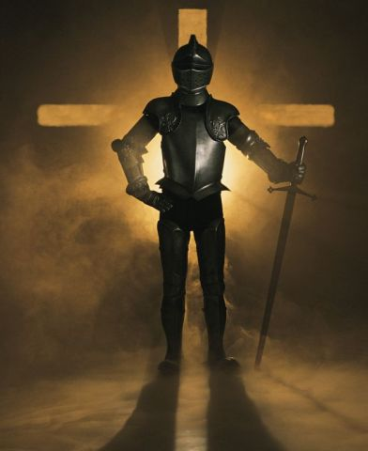
“Finally, my brethren, be strong in the Lord and in the power of His might.” Ephesians 6:10

