Slide 1
I believe in God but
I don’t go overboard
October 3, 2010
Part 2

Slide 2
Practical Atheist
Someone who believes in God,
but lives as if He doesn’t exist.
“Well did Isaiah prophesy of you hypocrites, as it is written: ‘This people honors Me with their lips, but their heart is far from Me.’” Mark 7:6

Slide 3
Have you hurled recently?

Slide 4
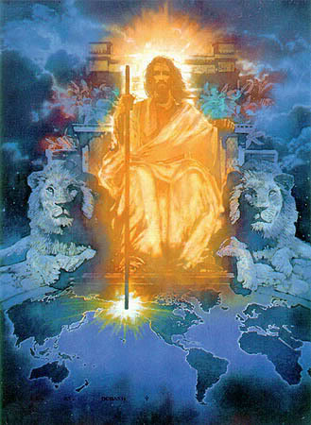

Slide 5
“And to the angel of the church of the Laodiceans write, ‘These things says the Amen, the Faithful and True Witness, the Beginning of the creation of God: “I know your works, that you are neither cold nor hot. I could wish you were cold or hot.” Revelation 3:14-15

Slide 6
“So then, because you are lukewarm, and neither cold nor hot, I will vomit you out of My mouth.’”
Revelation 3:16

Slide 7
Lukewarm Christians?

Slide 8
Lukewarm Christians?
Seek acceptance from PEOPLE more than acceptance from GOD
“Woe to you when all men speak well of you, for so did their fathers to the false prophets.” Luke 6:26
“But whoever denies Me before men, him I will also deny before My Father who is in heaven.” Matthew 10:33

Slide 9
Lukewarm Christians?
Do whatever it takes to alleviate their GUILT
“The sacrifices of God are a broken spirit; a broken and contrite heart, O God, you will not despise.” Psalm 51:17

Slide 10
Lukewarm Christians?
Think more about life on EARTH than eternity in HEAVEN
“Do not lay up for yourselves treasures on earth, where moth and rust destroy and where thieves break in and steal; but lay up for yourselves treasures in heaven, where neither moth nor rust destroys and where thieves do not break in and steal.” Matthew 6:19-20

Slide 11
Lukewarm Christians?
Only turn to God when they are in a BIND
“I am the vine, you are the branches. He who abides in Me, and I in him, bears much fruit; for without Me you can do nothing.” John 15:5

Slide 12
Lukewarm Christians?
Are not that much DIFFERENT from the rest of the world
“Do not be conformed to this world…” Romans 12:2

Slide 13
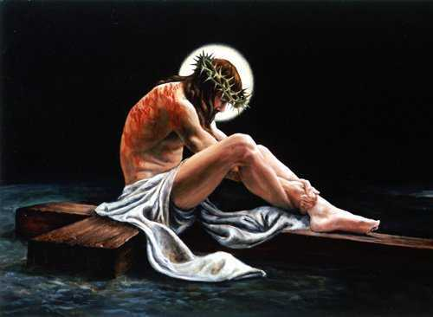
What’s your full time job?

Slide 14
What’s your full time job?
“Because you say, ‘I am rich, have become wealthy, and have need of nothing’—and do not know that you are wretched, miserable, poor, blind, and naked…” Revelation 3:17

Slide 15
What’s your full time job?
“Behold, I stand at the door and knock. If anyone hears My voice and opens the door, I will come in to him and dine with him, and he with Me.” Revelation 3:20

Slide 16
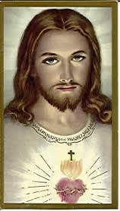
“For the love of Christ compels us, because we judge thus: that if One died for all, then all died; and He died for all, that those who live should live no longer for themselves, but for Him who died for them and rose again.” 2 Corinthians 5:14-15

