Slide 1
Quit Living in fear
February 13, 2011
Part 3

Slide 2
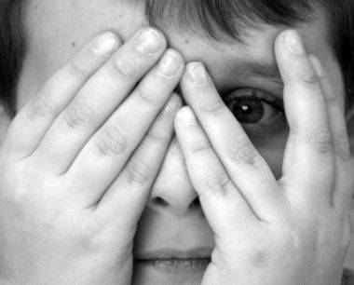
What are your hidden fears?

Slide 3
Life’s Most Common Fears
_____ Fear of Loss
_____ Fear of Failure
_____ Fear of Rejection
_____ Fear of the Unknown

Slide 4
2 Timothy 1:7
“For God has not given us a spirit of fear, but of power and of love and of a sound mind.”

Slide 5
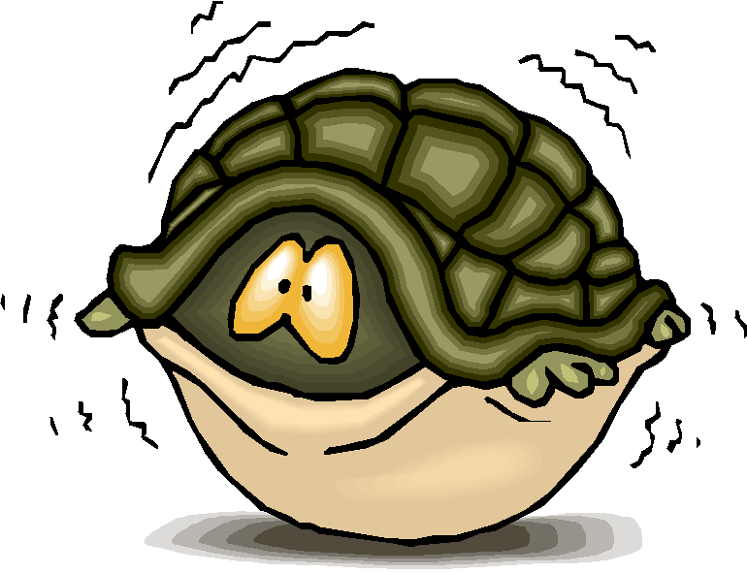
What is fear?

Slide 6
What is fear?
Fear is placing faith in the “WHAT IFS?”

Slide 7
What is fear?
Fear is placing faith in the “WHAT IFS?”
“Moses answered, "What if they do not believe me or listen to me and say, 'The Lord did not appear to you'?" Exodus 4:1

Slide 8
Why do your “what ifs” matter?

Slide 9
Why do your “what ifs” matter?
What you fear reveals what you VALUE MOST.

Slide 10
Why do your “what ifs” matter?
What you fear reveals what you VALUE MOST.
What you fear reveals where you TRUST LEAST.

Slide 11
Facing the “what ifs” of fear

Slide 12
Facing the “what ifs” of fear
Acknowledge your fear and choose to trust God.

Slide 13
Psalm 56:2-4
“My slanderers pursue me all day long; many are attacking me in their pride. When I am afraid, I will trust in you. In God, whose word I praise, in God I trust; I will not be afraid. What can mortal man do to me?”

Slide 14
Matthew 10:28
“And do not fear those who kill the body but cannot kill the soul”

Slide 15
Facing the “what ifs” of fear
Acknowledge your fear and choose to trust God.
Seek God until He takes away your fears.

Slide 16
Psalm 34:4
“I sought the LORD, and He heard me, and delivered me from all my fears.”

Slide 17
"I have never known more than fifteen minutes of anxiety or fear. Whenever I feel fearful emotions overtaking me I just close my eyes and thank God that he is still on the throne reigning over everything and I take comfort in His control over all the affairs of my life.”

Slide 18
But what if…?
But what if…?
But what if…?
But what if…?
But what if…?
But what if…?

Slide 19
But what if…?
But what if…?
But what if…?
“I sought the LORD,
and He heard me,
and delivered me from all my fears.”
Psalm 34:4
But what if…?
But what if…?
But what if…?

Slide 20
“For you did not receive the spirit of bondage again to fear, but you received the Spirit of adoption by whom we cry out, "Abba, Father."”
Romans 8:15

