Slide 1
Third Sunday of Lent
March 11, 2012

Slide 2
Psalm 79:8-9
“Let Your tender mercies come speedily to meet us, for we have been brought very low. Help us, O God of our salvation, for the glory of Your name.”

Slide 3
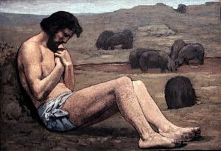

Slide 4
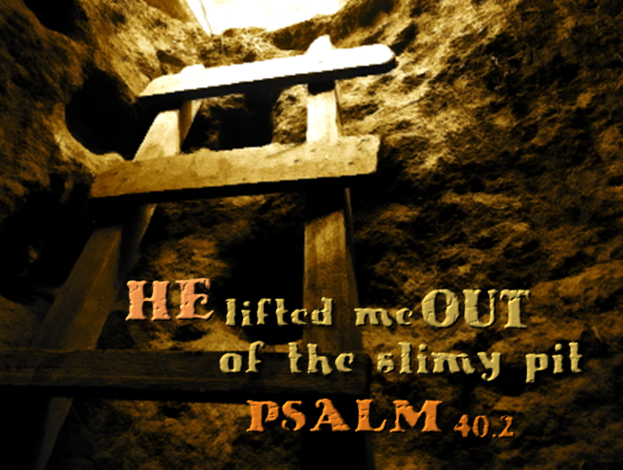

Slide 5
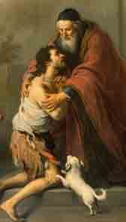
You weren’t made to live in a pit

Slide 6
2 Corinthians 6:4-10
But in all things we commend ourselves as ministers of God: in much patience, in tribulations, in needs, in distresses, in stripes, in imprisonments, in tumults, in labors, in sleeplessness, in fastings…

Slide 7
2 Corinthians 6:4-10
…by honor and dishonor, by evil report and good report; as deceivers, and yet true; as unknown, and yet well known; as dying, and behold we live; as chastened, and yet not killed; as sorrowful, yet always rejoicing; as poor, yet making many rich; as having nothing, and yet possessing all things.”

Slide 8
The best part…IT’S FREE!

Slide 9
Question is not how you got there. The question is when are you going to get out?

