Slide 1
Courage and Perseverance
August 17, 2011
Part 7
Part 1 - Title

Slide 2
The Death of King Ahab
See 1 Kings 21, 22

Slide 3
The Death of King Ahab
The reign of his son Ahaziah
See 2 Kings 1

Slide 4
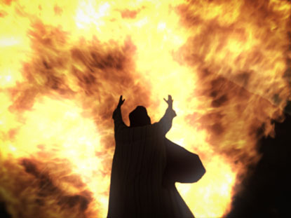
Why so harsh???

Slide 5
Why so harsh???
Old Testament vs New Testament
Era of truth vs era of mercy
Child vs YAMer

Slide 6
Why so harsh???
“For whom the LORD loves He chastens, and scourges every son whom He receives.” Hebrews 12:6
“Do not withhold correction from a child, for if you beat him with a rod, he will not die. You shall beat him with a rod, and deliver his soul from hell.” Proverbs 23:13-14

Slide 7
Why so harsh???
See Luke 9:51-56

Slide 8
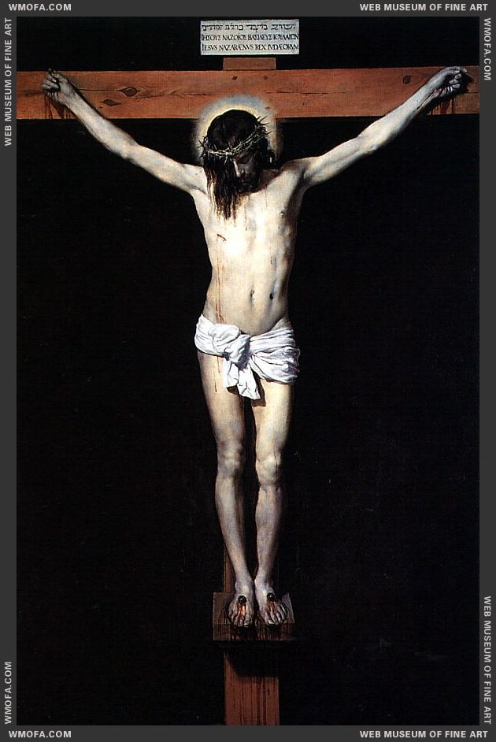
“…who, when He was reviled, did not revile in return; when He suffered, He did not threaten, but committed Himself to Him who judges righteously”
1 Peter 2:23

Slide 9
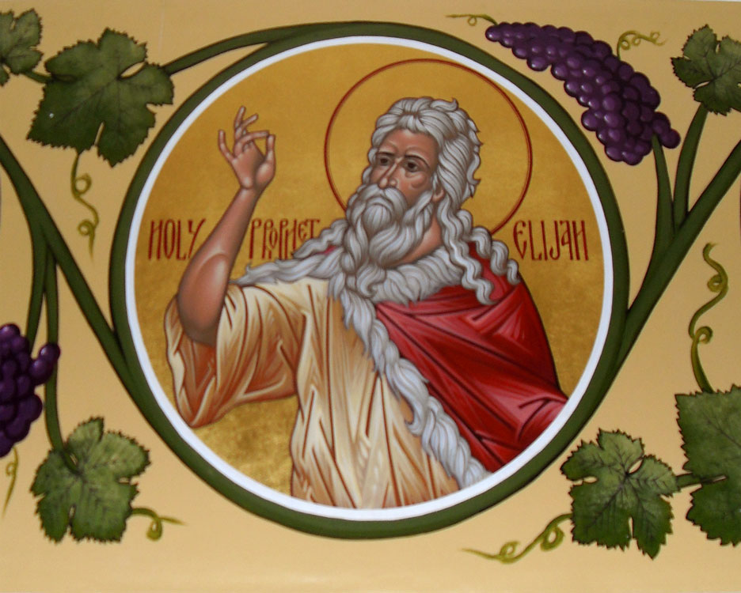
Elijah: Courage + Perseverance

Slide 10
Elijah: Courage + Perseverance
“But he who endures to the end shall be saved.” Matthew 24:13
“By your patience possess your souls.” Luke 12:19

