Slide 1
“You can’t handle it all”
Deceiving Truths
Part 3

Slide 2
Got a lot on your mind?

Slide 3
VIDEO GOES HERE

Slide 4
YOU ARE SO BUSY – YOU ARE OUT OF IT!

Slide 5
YOU ARE SO BUSY – YOU ARE OUT OF IT!
Out of shape PHYSICALLY

Slide 6
YOU ARE SO BUSY – YOU ARE OUT OF IT!
Out of shape PHYSICALLY
Out of sorts EMOTIONALLY

Slide 7
YOU ARE SO BUSY – YOU ARE OUT OF IT!
Out of shape PHYSICALLY
Out of sorts EMOTIONALLY
Out of touch RELATIONALLY

Slide 8
YOU ARE SO BUSY – YOU ARE OUT OF IT!
Out of shape PHYSICALLY
Out of sorts EMOTIONALLY
Out of touch RELATIONALLY
Out of order SPIRITUALLY

Slide 9
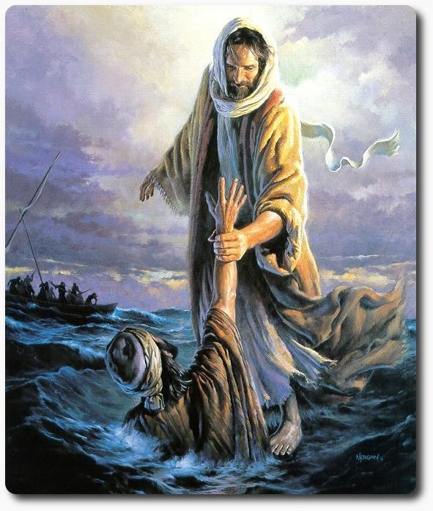
It’s time for a “COME TO JESUS” meeting

Slide 10
It’s time for a “COME TO JESUS” meeting
“Come to Me, all you who labor and are heavy laden, and I will give you rest. Take My yoke upon you and learn from Me, for I am gentle and lowly in heart, and you will find rest for your souls. For My yoke is easy and My burden is light.” Matthew 11:28-30

Slide 11
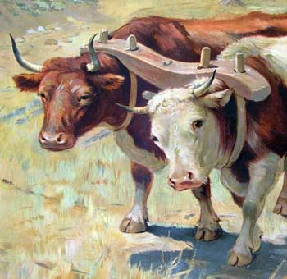
It’s time for a “COME TO JESUS” meeting
Yoke controls
direction & pace

Slide 12
Too many things to do?

Slide 13
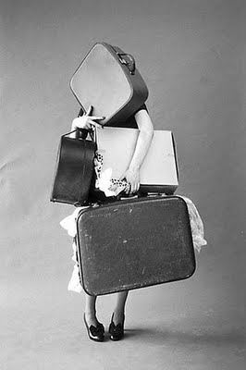
Too many things to do?
Some things need to be SHARED.

Slide 14
Too many things to do?
Some things need to be SHARED.
“Moses' father-in-law replied, "What you are doing is not good. You and these people who come to you will only wear yourselves out. The work is too heavy for you; you cannot handle it alone.” Exodus 18:17-18

Slide 15
Too many things to do?
Some things need to be SHARED.
“Bear one another’s burdens, and so fulfill the law of Christ.” Galatians 6:2

Slide 16
Too many things to do?
Some things need to be STOPPED.

Slide 17
Too many things to do?
Some things need to be STOPPED.
“And Jesus answered and said to her, “Martha, Martha, you are worried and troubled about many things. But one thing is needed, and Mary has chosen that good part, which will not be taken away from her.” Luke 10:41-42

Slide 18
Too many things to do?
Some things need to be STOPPED.
“If I had more time I would ... “

Slide 19
Too many things to do?
Some things need to be STOPPED.
“Be still, and know that I am God.” Psalm 46:10

Slide 20
Too many things to do?
Some things need to be STOPPED.
“Be still, and know that I am God.” Psalm 46:10
What do you need to
add to your “to don’t” list?

Slide 21
Too many things to do?
Everything needs to be SURRENDERED.

Slide 22
Too many things to do?
Everything needs to be SURRENDERED.
“My soul finds rest in God alone; my salvation comes from him.” Psalm 62:1
“Cast your cares on the LORD and he will sustain you.” Psalm 55:22

Slide 23
Too many things to do?
Everything needs to be SURRENDERED.
God will never give you
more than HE can bear.

Slide 24
What radical change do you
need to make?

Slide 25
You will never regret sacrificing
the “good” for the “better”

