Slide 1
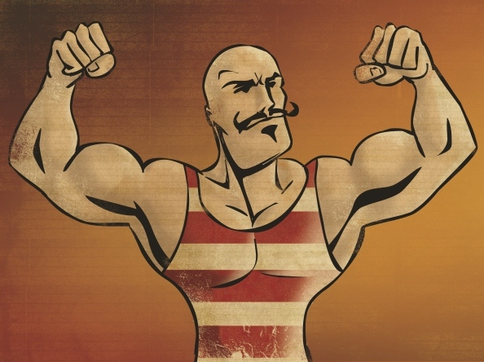
“you’re not good enough”
Deceiving Truths
Part 1

Slide 3
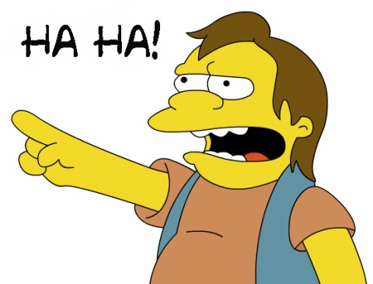

Slide 4


Slide 5
I am not working FOR God’s acceptance & approval; I am working FROM God’s acceptance & approval.

Slide 6
Abraham: “I am nothing but dust and ashes.” Genesis 18:27
Isaiah: “Woe to me!...I am ruined! For I am a man of unclean lips…” Isaiah 6:5
Peter: “Depart from me, for I am a sinful man, O Lord!” Luke 5:8
Paul: “Christ Jesus came into the world to save sinners, of whom I am chief.” 1 Timothy 1:15

Slide 7

“For all have sinned
and fall short of the glory of God.”
Romans 3:23

Slide 8
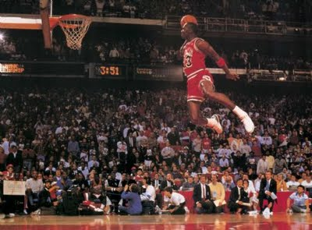

Slide 9

The performance trap

Slide 10
The performance trap
“For we…have no confidence in the flesh, though I also might have confidence in the flesh. If anyone else thinks he may have confidence in the flesh, I more so: circumcised the eighth day, of the stock of Israel, of the tribe of Benjamin, a Hebrew of the Hebrews; concerning the law, a Pharisee; concerning zeal, persecuting the church; concerning the righteousness which is in the law, blameless.” Philippians 3:4-6

Slide 11
The performance trap
We attempt to please God by following rules.

Slide 12
The performance trap
We attempt to please God by following rules.
My worth is based on what I produce and how I perform.

Slide 13
Philippians 3:7-8
“But what things were gain to me, these I have counted loss for Christ. Yet indeed I also count all things loss for the excellence of the knowledge of Christ Jesus my Lord, for whom I have suffered the loss of all things, and count them as rubbish [sku-bala], that I may gain Christ.”

Slide 14
Philippians 3:9
“…and be found in Him, not having my own righteousness, which is from the law, but that which is through faith in Christ, the righteousness which is from God by faith.”

Slide 15
Ephesians 2:4-7
“But God, who is rich in mercy, because of His great love with which He loved us, even when we were dead in trespasses, made us alive together with Christ (by grace you have been saved), and raised us up together, and made us sit together in the heavenly places in Christ Jesus, that in the ages to come He might show the exceeding riches of His grace in His kindness toward us in Christ Jesus….

Slide 16
Ephesians 2:8-10
…For by grace you have been saved through faith, and that not of yourselves; it is the gift of God, not of works, lest anyone should boast. For we are His workmanship, created in Christ Jesus for good works, which God prepared beforehand that we should walk in them.

Slide 17
Ephesians 2:8-10
…For by grace you have been saved through faith, and that not of yourselves; it is the gift of God, not of works, lest anyone should boast. For we are His workmanship, created in Christ Jesus for good works, which God prepared beforehand that we should walk in them.
Our works are a load of SKUBALA

Slide 18
You’re not good enough
“But when God…called me by his grace…to reveal his Son in me so that I might preach him among the Gentiles…” Galatians 1:15-16

Slide 19
You’re not good enough
“But when God…called me by his grace…to reveal his Son in me so that I might preach him among the Gentiles…” Galatians 1:15-16
I am not working FOR God’s acceptance & approval; I am working FROM God’s acceptance & approval.

