Slide 1
Eight Foot Ceilings
June 20, 2010 – Part 4

Slide 2
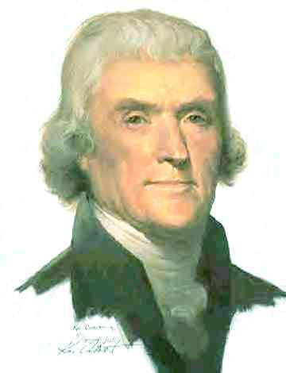

Slide 3
Biggest mistake you can make is thinking about God in human terms and with human limits

Slide 4
Biggest mistake you can make is thinking about God in human terms and with human limits
“To whom then will you liken Me, or to whom shall I be equal?” says the Holy One. Lift up your eyes on high, and see who has created these things…” Isaiah 40:25

Slide 5
Biggest mistake you can make is thinking about God in human terms and with human limits
“For as the heavens are higher than the earth, so are My ways higher than your ways, and My thoughts than your thoughts.” Isaiah 55:9

Slide 6
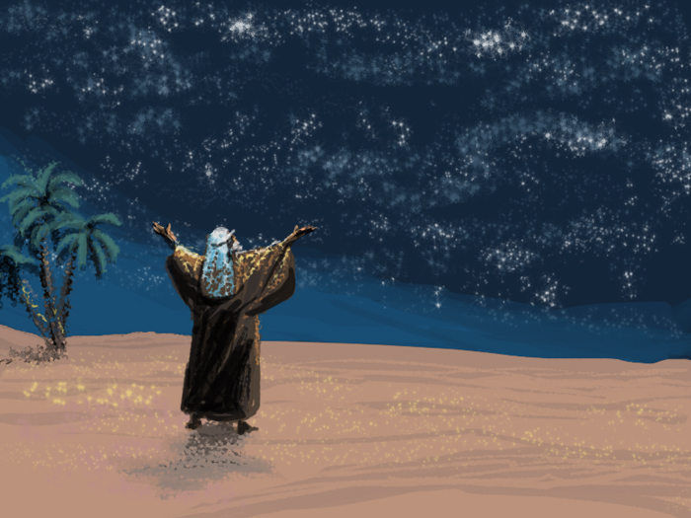
“Then He brought him outside and said, Look now toward heaven, and count the stars if you are able to number them. And He said to him, So shall your descendants be.” Genesis 15:5

Slide 7
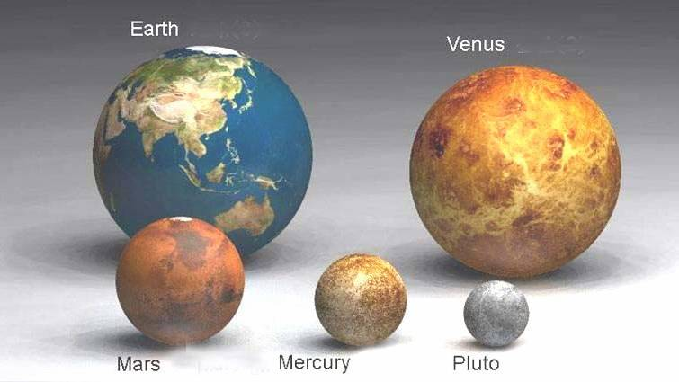

Slide 8
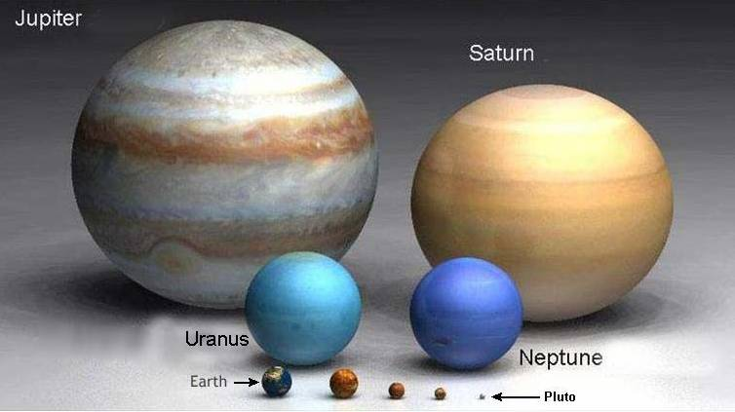

Slide 9
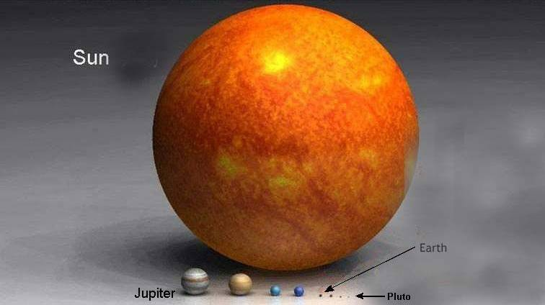

Slide 10
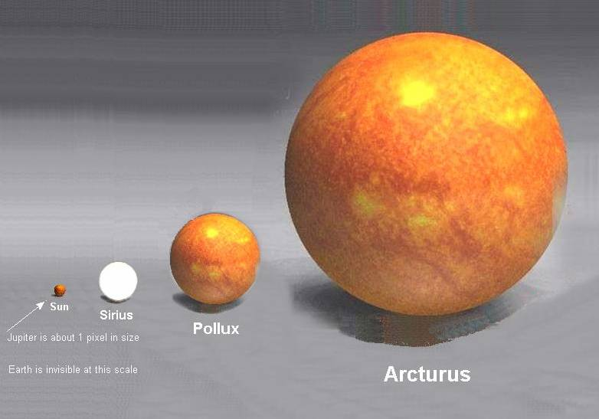

Slide 11
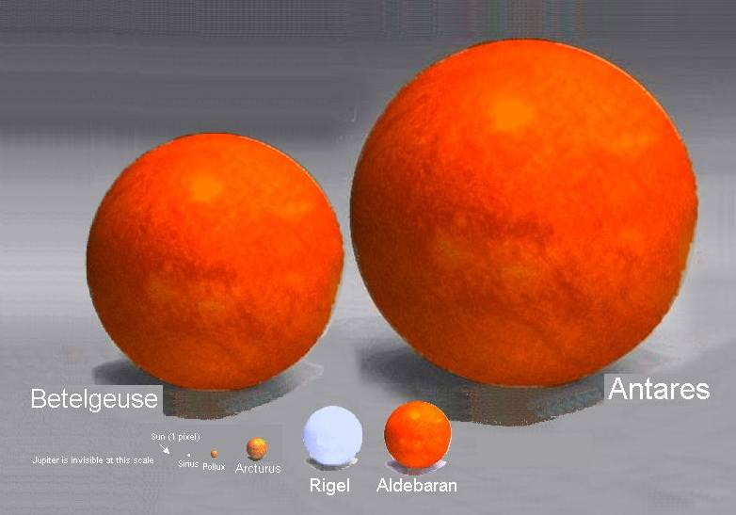

Slide 12
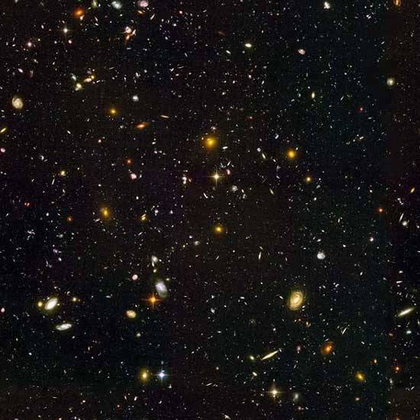

Slide 13
“He counts the number of the stars; He calls them all by name. Great is our Lord, and mighty in power; His understanding is infinite.” Psalm 147:4-5

Slide 14
We need to do more star-gazing and less ceiling-gazing

Slide 15
We need to do more star-gazing and less ceiling-gazing
“And if anyone thinks that he knows anything, he knows nothing yet as he ought to know.” 1 Corinthians 8:2

Slide 16
We need to do more star-gazing and less ceiling-gazing
“And if anyone thinks that he knows anything, he knows nothing yet as he ought to know.” 1 Corinthians 8:2
‘Critical realism’

Slide 17
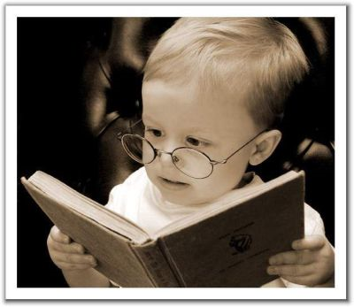
A Lesson From Kids

Slide 18
A Lesson From Kids
“Assuredly, I say to you, unless you are converted and become as little children, you will by no means enter the kingdom of heaven.” Matthew 18:3

Slide 19
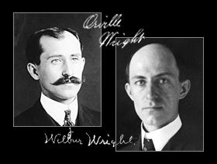
A Lesson From Kids

Slide 20
“Against all hope, Abraham in hope believed and so became the father of many nations, just as it had been said to him, "So shall your offspring be." Without weakening in his faith, he faced the fact that his body was as good as dead—since he was about a hundred years old—and that Sarah's womb was also dead. Yet he did not waver through unbelief regarding the promise of God, but was strengthened in his faith and gave glory to God, being fully persuaded that God had power to do what he had promised.” Romans 4:18-21

Slide 21
Faith isn’t logical. Faith isn’t illogical.

Slide 22
Faith isn’t logical. Faith isn’t illogical. Faith is THEO-logical

Slide 23
What eight foot ceilings are you putting on God?

Slide 24
What eight foot ceilings are you putting on God?
“He who observes the wind will not sow, and he who regards the clouds will not reap.” Ecclesiastes 11:4

Slide 25
What eight foot ceilings are you putting on God?
“I can do all things through Christ who strengthens me.” Philippians 4:13

Slide 26
Without God, the best I can do is the best I can do. With God, the possibilities are endless.
“Now to Him who is able to do exceedingly abundantly above all that we ask or think, according to the power that works in us” Ephesians 3:20

Slide 27
Genesis 21:1-5
“And the LORD visited Sarah as He had said, and the LORD did for Sarah as He had spoken. For Sarah conceived and bore Abraham a son in his old age, at the set time of which God had spoken to him. And Abraham called the name of his son who was born to him—whom Sarah bore to him—Isaac…Now Abraham was one hundred years old when his son Isaac was born to him…

Slide 28
Genesis 21:6-7
And Sarah said, “God has made me laugh, and all who hear will laugh with me.” She also said, “Who would have said to Abraham that Sarah would nurse children? For I have borne him a son in his old age.”

Slide 29
Every Wild Goose chase starts with one small step of faith
“By faith Abraham obeyed when he was called to go out to the place which he would receive as an inheritance. And he went out, not knowing where he was going.” Hebrews 11:8

Slide 30
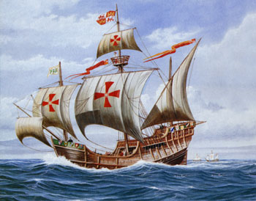
Christopher Columbus

Slide 31
Christopher Columbus
“It was the Lord who put it in my mind, I could feel His hand upon me, the fact that it would be possible to sail from here to the Indies. All who heard of my project rejected it with laughter, ridiculing me. there is no question that the inspiration was from the HS, because He comforted me with rays of marvelous inspiration from the Holy Scriptures.” The Light and the Glory, by Peter Marshall and David Manuel

Slide 32
“People cannot discover new lands until they have courage to lose sight of shore”

