Slide 1
Another Ordinary Day
June 13, 2010 – Part 3

Slide 2
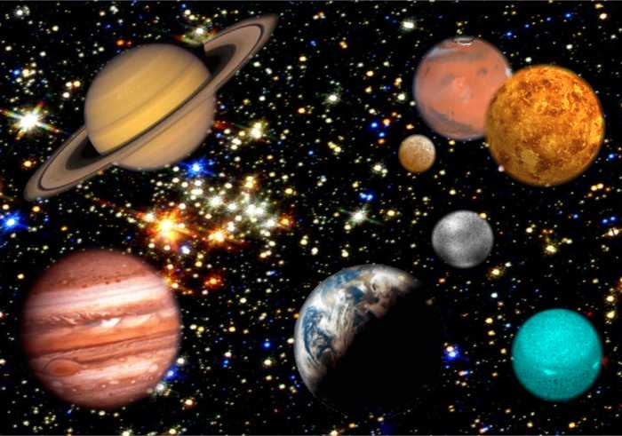

Slide 3
The more something is constant; the more we take it for granted

Slide 4
The more something is constant; the more we take it for granted
“Do not cast me from your presence or take your Holy Spirit from me. Restore to me the joy of your salvation” Psalm 51:11-12

Slide 5
The Cage of Routine
Disequilibrium = LIFE
Equilibrium = DEATH

Slide 6
The Cage of Routine
change of PLACE + change of PACE
=
change of PERSPECTIVE

Slide 7
Exodus 3:1-5
“Now Moses was tending the flock of Jethro his father-in-law, the priest of Midian. And he led the flock to the back of the desert, and came to Horeb, the mountain of God. And the Angel of the LORD appeared to him in a flame of fire from the midst of a bush. So he looked, and behold, the bush was burning with fire, but the bush was not consumed…

Slide 8
Exodus 3:1-5
Then Moses said, “I will now turn aside and see this great sight, why the bush does not burn.”
So when the LORD saw that he turned aside to look, God called to him from the midst of the bush and said, “Moses, Moses!”
And he said, “Here I am.”

Slide 9
Exodus 3:1-5
Then He said, “Do not draw near this place. Take your sandals off your feet, for the place where you stand is holy ground.”

Slide 10
Exodus 3:1-5
Then He said, “Do not draw near this place. Take your sandals off your feet, for the place where you stand is holy ground.”
Maybe there is holy ground
closer than you think…

Slide 11
“Now after six days Jesus took Peter, James, and John his brother, led them up on a high mountain by themselves…” Matthew 17:1

Slide 12
New places set the tone for new experiences
“Now after six days Jesus took Peter, James, and John his brother, led them up on a high mountain by themselves…” Matthew 17:1

Slide 13
New places set the tone for new experiences
“And no one puts new wine into old wineskins; or else the new wine will burst the wineskins and be spilled, and the wineskins will be ruined. But new wine must be put into new wineskins, and both are preserved.” Luke 5:37-38

Slide 14
A Change of Pace
“Remember the Sabbath day, to keep it holy. Six days you shall labor and do all your work, but the seventh day is the Sabbath of the LORD your God. In it you shall do no work” Exodus 20:8-10

Slide 15
A Change of Pace
“And whatever you do, do it heartily, as to the Lord and not to men” Colossians 3:23

Slide 16
A Change of Pace
“Be still and know that I am God” Psalm 46:10

Slide 17
Result of not slowing the pace?

Slide 18
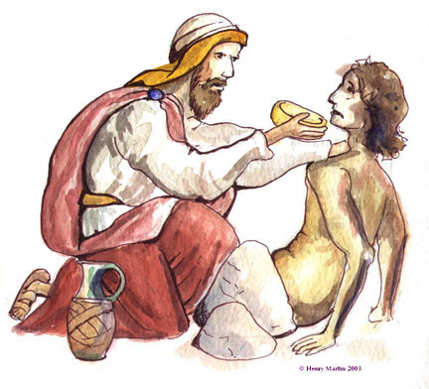
Result of not slowing the pace?
I will miss divine appointments

Slide 19
HURRY KILLS EVERYTHING!

Slide 20
HURRY KILLS EVERYTHING!
“And when he heard that it was Jesus of Nazareth, he began to cry out and say, “Jesus, Son of David, have mercy on me!” Then many warned him to be quiet; but he cried out all the more, “Son of David, have mercy on me!” So Jesus stood still and commanded him to be called.” Mark 10:47-49

Slide 21
So are routines/habits bad?

Slide 22
So are routines/habits bad?
Good routines become bad routines if we don’t change the routine

Slide 23
So are routines/habits bad?
Good routines become bad routines if we don’t change the routine
“Inasmuch as these people draw near with their mouths and honor Me with their lips, but have removed their hearts far from Me” Isaiah 29:13

Slide 24
Exodus 4:2-3
“So the LORD said to him, “What is that in your hand?” He said, “A rod.” And He said, “Cast it on the ground.” So he cast it on the ground, and it became a serpent; and Moses fled from it.”

Slide 25
What is God calling you to throw down?

Slide 26
What is God calling you to throw down?
“But lift up your rod, and stretch out your hand over the sea and divide it. And the children of Israel shall go on dry ground through the midst of the sea.” Exodus 14:16

