Slide 1
Back to Basics
August 8, 2010
Part 1

Slide 2
Why do I need theology/doctrine?
“You shall love the LORD your God…with all your MIND” Mark 12:30

Slide 3
Why do I need theology/doctrine?
You can’t love someone that you don’t know
“And this is eternal life, that they may know You, the only true God, and Jesus Christ whom You have sent.” John 17:3

Slide 4
Why do I need theology/doctrine?
Your behavior is based on your beliefs
“My people are destroyed for lack of knowledge.” Hosea 4:6

Slide 5
Why do I need theology/doctrine?
Having faith ≠ having correct faith
“For the time will come when they will not endure sound doctrine, but according to their own desires, because they have itching ears, they will heap up for themselves teachers; and they will turn their ears away from the truth, and be turned aside to fables.” 2 Timothy 4:3-4

Slide 6
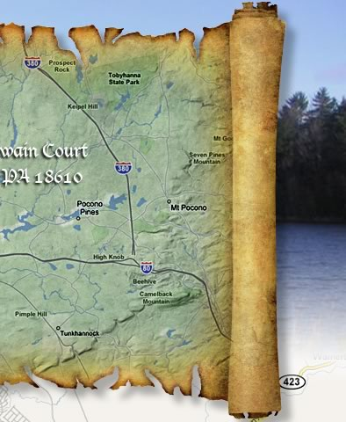
Our doctrine: Orthodox/Nicene Creed
We believe in One God…

Slide 7
Our doctrine: Orthodox/Nicene Creed
We believe in One God…
Huh?
One God?
Or three Gods?

Slide 8
What/Who is the Holy Trinity?

Slide 9
What/Who is the Holy Trinity?
“In the beginning God created the heavens and the earth. The earth was without form, and void; and darkness was on the face of the deep. And the Spirit of God was hovering over the face of the waters.” Genesis 1:1-2

Slide 10
What/Who is the Holy Trinity?
“For there are three that bear witness in heaven: the Father, the Word, and the Holy Spirit; and these three are one” 1 John 5:7

Slide 11
What/Who is the Holy Trinity?
The Trinity is a Person/Relationship
“God is love” 1 John 4:8

Slide 12
What/Who is the Holy Trinity?
The Trinity is a Person/Relationship
“He [Christ] is the image of the invisible God” Colossians 1:15

Slide 13
What/Who is the Holy Trinity?
Three Persons [Hypostases],
One Essence [Ousia]

Slide 14
What/Who is the Holy Trinity?
Three Persons [Hypostases],
One Essence [Ousia]
“Let Us make man in Our image, according to Our likeness” Genesis 1:26

Slide 15
What/Who is the Holy Trinity?
Three Persons [Hypostases],
One Essence [Ousia]
“Go therefore and make disciples of all the nations, baptizing them in the name of the Father and of the Son and of the Holy Spirit…” Matthew 28:19

Slide 16
What/Who is the Holy Trinity?
The Father is the Source of all. He begets the Son & sends forth the Spirit.

Slide 17
FATHER
IS
Begotten from
Proceeds from
GOD
IS
IS
HOLY SPIRIT
SON
Sends

Slide 18
What/Who is the Holy Trinity?
The Father is the Source of all. He begets the Son & sends forth the Spirit.
“No one has seen God at any time. The only begotten Son, who is in the bosom of the Father, He has declared Him.” John 1:18

Slide 19
What/Who is the Holy Trinity?
The Father is the Source of all. He begets the Son & sends forth the Spirit.
“But when the Helper comes, whom I shall send to you from the Father, the Spirit of truth who proceeds from the Father, He will testify of Me.” John 15:26

Slide 20
FATHER
(above us)
IS
Begotten from
Proceeds from
GOD
IS
IS
HOLY SPIRIT
(inside us)
SON
(beside us)
Sends

Slide 21
Who Cares?

Slide 22
Who Cares?
“But the hour is coming, and now is, when the true worshipers will worship the Father in spirit and truth; for the Father is seeking such to worship Him. God is Spirit, and those who worship Him must worship in spirit and truth.” John 4:23-24

Slide 23
