Slide 1
Weird is Better
Weird Series Light and Life Fall 2011

Slide 2
Key Thought
If you want what normal people have, do what normal people do.
If you want what few people have, do what few people do!

Slide 3
Truth
It’s not just that it’s OK to be different, but when you are led by the Spirit of God
ITS WAY BETTER TO BE DIFFERENT

Slide 4
1 Peter 1:15-16
“But as He who called you is holy, you also be holy in all your conduct, because it is written, “Be holy, for I am Holy.”

Slide 5

Greek word for Holy
“Hagios”- to be pure; it means to be set apart, it literally means to be different

Slide 6
Goal is not weird for weird sake, your goal is to please God.

Slide 7
Psalm 69:9-12
“Because zeal for Your house has eaten me up,
And the reproaches of those who reproach You have fallen on me.
¹⁰ When I wept and chastened my soul with fasting, That became my reproach.
¹¹ I also made sackcloth my garment;
I became a byword to them.
¹² Those who sit in the gate speak against me,
And I am the song of the drunkards.”

Slide 8
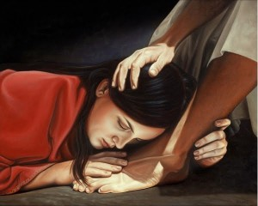
This is passion for
what matters to God

Slide 9
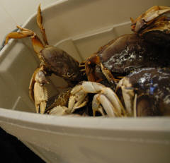
Don’t get stuck in the bucket!

Slide 10
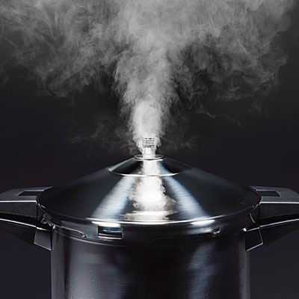
Inward pressure- the need to please

Slide 11
Proverbs 29:25
“The fear of man brings a snare,
But whoever trusts in the LORD shall be safe.”

Slide 12
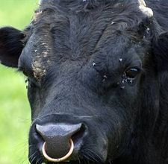
“Moquesh”- Hebrew word for trap or snare; literally word used to describe a ring put into an animal’s nose

Slide 13
Becoming obsessed with what people think about you is the quickest way to forget what God thinks about you

Slide 14
Galatians 1:10
“ If I still pleased men, I would not be a bondservant of Christ.”

Slide 15
Romans 6:16
“¹⁶ Do you not know that to whom you present yourselves slaves to obey, you are that one’s slaves whom you obey, whether of sin leading to death, or of obedience leading to righteousness?”

Slide 16
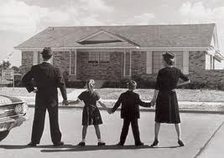
Family Identity
Wherever family identity is strong, peer pressure is going to be weak. But wherever family identity is weak, which is normal, peer pressure is going to be strong.

Slide 17
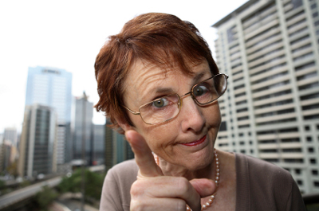
Outward pressure - CRITICISM

Slide 18
John 15:18-20
“If the world hates you, you know that it hated Me before it hated you. ¹⁹ If you were of the world, the world would love its own. Yet because you are not of the world, but I chose you out of the world, therefore the world hates you. ²⁰ Remember the word that I said to you, ‘A servant is not greater than his master.’ If they persecuted Me, they will also persecute you. If they kept My word, they will keep yours also.”

Slide 19
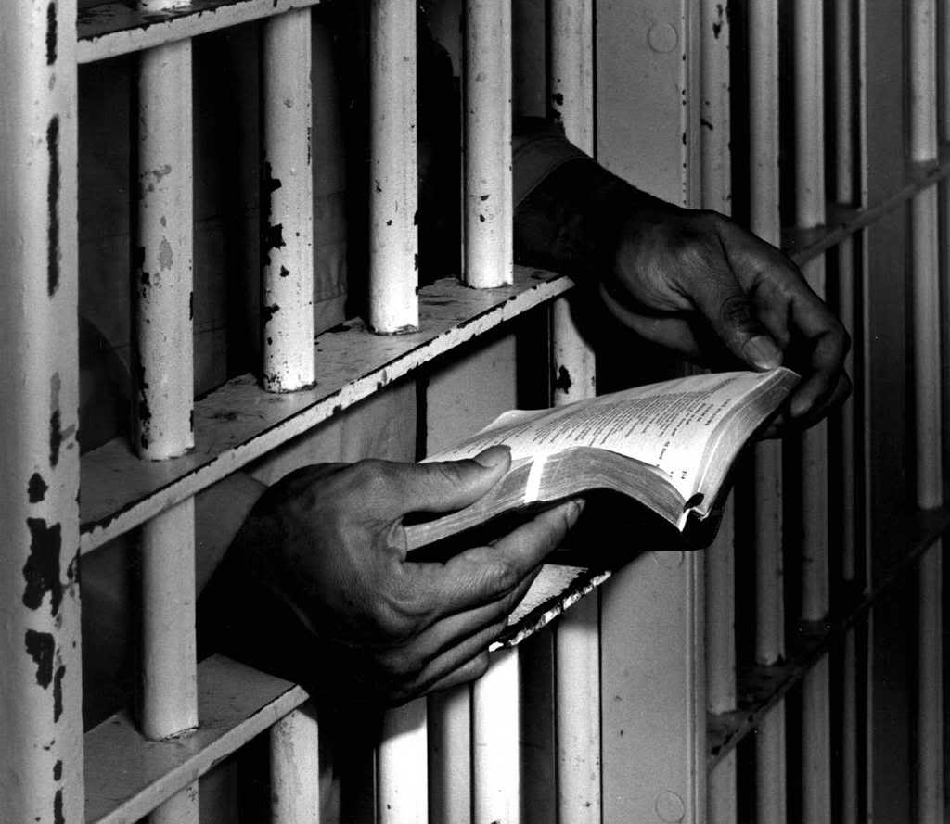
Rejoice in persecution
'Blessed are those who are persecuted because of righteousness, for theirs is the kingdom of heaven and blessed are you when people insult you, persecute you and falsely say all kinds of evil against you because of me. Rejoice and be glad, because great is your reward in heaven....'

