Slide 1
The Impact of One
Book of Esther – Part 4
September 8, 2010

Slide 2
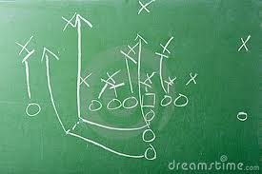
Are you ready for some football?

Slide 3
The Impact of One
“For the eyes of the LORD run to and fro throughout the whole earth, to show Himself strong on behalf of those whose heart is loyal to Him.”
2 Chronicles 16:9

Slide 4
The Impact of One
“So I sought for a man among them who would make a wall, and stand in the gap before Me on behalf of the land, that I should not destroy it; but I found no one.” Ezekiel 22:30

Slide 5
The People Mourn
See Esther 4:1-3

Slide 6
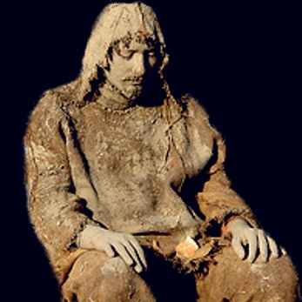
The People Mourn

Slide 7
The People Mourn
“But what did you go out to see? A man clothed in soft garments? Indeed, those who wear soft clothing are in kings’ houses.” Matthew 11:8

Slide 8
What does hardship do to a community?

Slide 9
What does hardship do to a community?
“Suffering never ruins a nation or breaks up a family…affluence does!”

Slide 10
The Queen Responds
See Esther 4:4-12

Slide 11
Three HUGE Statements

Slide 12
Three HUGE Statements
Do not think in your heart that you will escape
If you remain completely silent at this time, relief and deliverance will arise from another place
Who knows whether you have come to the kingdom for such a time as this?

Slide 13
The Heart of a Champion
See Esther 4:15-16

Slide 14
The Heart of a Champion
“If I perish, I perish!”

Slide 15
The Heart of a Champion
“If I perish, I perish!”
“And David said, “What have I done now? Is there not a cause?” 1 Samuel 17:29

Slide 16
What Difference Can I Make?

Slide 17
What Difference Can I Make?
“Yet who knows whether you have come to the kingdom for such a time as this?”
“If I perish, I perish!”

Slide 18
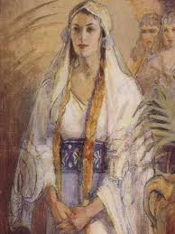
Two Principles to Remember

Slide 19
Two Principles to Remember
One person can make a difference

Slide 20
Two Principles to Remember
One person can make a difference
The only way to make a difference is to STAND UP and SPEAK UP

