Slide 1
Dogmatic Theology
Servants meeting November 3, 2010

Slide 2
Dogmatic Theology

Slide 3
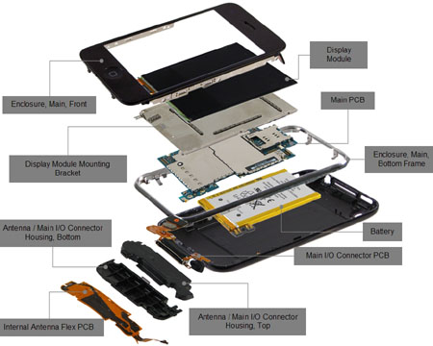
Dogmatic theology

Slide 4
Dogmatic theology
Oh, taste and see that the Lord is good.
Psalms 34:8

Slide 5
Dogmatic theology
1. God
The existence of God
God’s Character
Trinity (divinity of Father, Son and Holy Spirit)
Heresies against Trinity
Creation; good and evil …etc.

Slide 6
Dogmatic theology
2. Man
Man’s creation
What man is made of (Spirit, Soul and Body)
Man’s Fall and its results

Slide 7
Dogmatic theology
3. Christ
Incarnation
The Nature of Christ
The Divinity of Christ (its proof)

Slide 8
Dogmatic theology
4. Salvation and Redemption
The Necessity of Incarnation
The Need for Redemption
The Need for a Savior and His Characteristics
Prophecies on Salvation and the Savior
The blessings and the benefits of Salvation

Slide 9
Dogmatic theology
5. The church
The meaning of the church; its symbols in the OT
The mission of the church
Worship in Church
Rites in the church (prayers, fastings, feasts, saints …etc.)

Slide 10
Dogmatic theology
6. Heaven
Eschatology
The Everlasting Life
Hades and Paradise
Heaven and Hell
The second coming its heresies (Millennium, rapture …etc.)

Slide 11
Dogmatic theology
7. Angels
Angels and their Role in our Salvation
The Fall of Angles and Devil

Slide 12
Dogmatic theology
Now it all these 7 points; they must have the following:
1. Biblical Reference
2. Liturgical Life Reference
3. Patristic Reference

Slide 13
Dogmatic theology

Slide 14
Dogmatic theology

