Slide 1
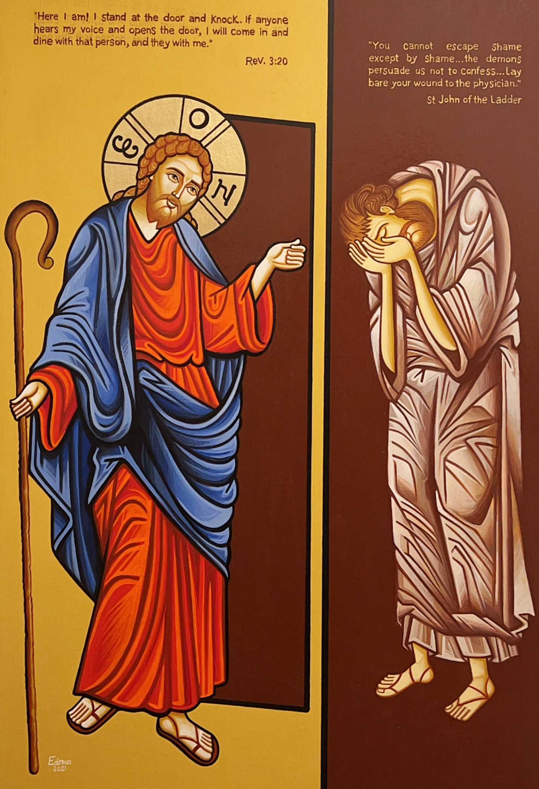
Schedule
St. Mark Marriage Retreat 2022
Talk 1: Fighting and Forgiving
Talk 2: Marriage as Salvation
Talk 3: Letting Christ in to heal the Marriage
Talk 4: Children as a means to Salvation

Slide 2
What does this Icon mean?

Slide 3
So why don’t we let Him in??
Scared of the consequences?
Scared to be judged?
Ashamed?

Slide 4
You cannot escape shame except by shame. It is often the habit of the demons to persuade us either not to confess, or to do so as if we were confessing another person’s sins, or to lay the blame for our sin on others. Lay bare, lay bare your wound to the physician and, without being ashamed, say: ‘It is my wound, Father, it is my plague, caused by my own negligence, and not by anything else. No one is to blame for this, no man, no spirit, no body, nothing but my own carelessness.’”
-St John of the Ladder

Slide 5
Shame Can Destroy a marriage…
Elder Porphyrios "Let us stretch out to Him and approach Him as a friend. Do we fall? Do we sin? With familiarity, love and trust let us run to Him - not with fear that He will punish us, but with the confidence which we deserve from the sense of being with a friend.
Prior sins can accumulate and create destructive shame.

Slide 6
You are not your sin… by Fr. Stephen Freeman
We can also experience, at a toxic level, shame that is self-inflicted. Any number of sinful actions can yield that result. And it is here that I want to intervene in this article and drive home a point: we are not our sin.
No human being is evil by nature. We are created fundamentally good (even “very good” in the language of Genesis). And though we may do many things, and many things may be done to us, none of them change “who we are.” Sin is not a constitutive part of our existence. It is extra-human, and external to our nature.

Slide 7
How do I fix the shame?
HE has to cover me….
How? I let him in.
Into my body through Eucharist
Into my life through repentance.
Shame:
Leads to self condemnation.
Leads to isolation.
Leads to condemnation and attacking
of others.
The pain makes me lash out.

Slide 8
So why don’t we let Him in??
Scared of the consequences?
Scared to be judged?
Ashamed?
Maybe we don’t know it’s Christ??

Slide 9
The Born Blind Man…
During lent We heard the story of the man who born blind. And then the disciples asked who sinned? This man or his parents. Why did they ask?
What does every Philosophy professor ask the students on the first day of college to stump them about their belief in God?
Why does a good God do bad things? Why is there famine? War? Genocide? Murder? Pedophilia?
Because a Good God doesn’t do bad things? Right? That’s why the disciples asked him!
So was this man’s blindness God’s will? - Are “bad things” God’s will??

Slide 10
Why did Jesus get crucified?
“For God so loved the world, that he gave his only Son, that whoever believes in him should not perish but have eternal life.”
“He is the propitiation for our sins, and not for ours only but also for the sins of the whole world.”
“For the wages of sin is death, but the free gift of God is eternal life in Christ Jesus our Lord.”
“For our sake he made him to be sin who knew no sin, so that in him we might become the righteousness of God.”
St. Athanasius tells us that this wasn’t the backup plan or plan B, it was always the plan from the beginning of time! The plan from even before Adam fell!

Slide 11
But wait? Who did it? How did it actually happen?
Wasn’t it Judas’ greed??
Wasn’t it the pharisees jealousy and hypocrisy??
Wasn’t it the chief priests fear of Roman wrath??
Wasn’t it ultimately Pontius Pilot’s call and his fear of another uprising??
So wasn’t it man’s will?!?
They did it right? And wasn’t it completely their choice?
And were their choices God’s will?
God’s will - love your neighbor as yourself.
Did those people, Judas, the pharisees, the Chief priests, Pontius Pilate, did they do God’s will?
No!

Slide 12
So what was Christ’s response to all this evil?
He could of said “Look, I don’t accept this cross! This is not God's will, this cannot be God's will. It’s a bad things that comes from bad people with bad intentions.”
Rather he said: "Abba, Father, all things are possible to you; if you are willing, remove this cup from me; yet not what I will, but what you will” (Mk 14:36).
“all things are possible to you” - So Christ recognized that the Father could have done something. But that the Father allowed “such a horrible thing to happen”
Didn’t Satan ask God before he did “horrible things” to Job??

Slide 13
We all have crosses in our lives!
What if I have a difficult husband? Wife?
A sick child? Difficult child?
Problems at work?
Someone with cancer?
Difficult in-laws?
Children that are on the wrong path?
Trouble in the service?
Boss or coworkers that are out to get me?
Friends that stab me in the back and gossip about me?

Slide 14
But how do I, as a Christian, see these things when they happen to me??
Are those God’s will for me? Does God will that those people do bad things to me?
Here, we must distinguish between the actual deed of someone and the situation that comes to us as a result of the the sinful act.
It is not God's will that you ever hurt another.
But what if someone lies about you at work? Now that person’s lie will create for you a difficult situation. You may even get fired because someone lied about you.

Slide 15
But how do I, as a Christian, see these things when they happen to me??
God's does not will that someone slander you at work. And that person, will be judged for the action they took with their own free will.
Here comes the difference, the consequences of that difficult situation, God has allowed to happen.
That situation came to you from God’s hands. Look at the story of Job! Satan always did what before he struck Job? He asked God’s permission!
So at some level, in some way, our lives are arranged. And God has allowed challenging things to happen to us, sometimes because of the evil of other people.
God’s will is to allow events that are difficult and painful and he allows Judas and the pharisees, and the chief priests and the Pontius pilate and the soldiers to do whatever evil they wanted.

Slide 16
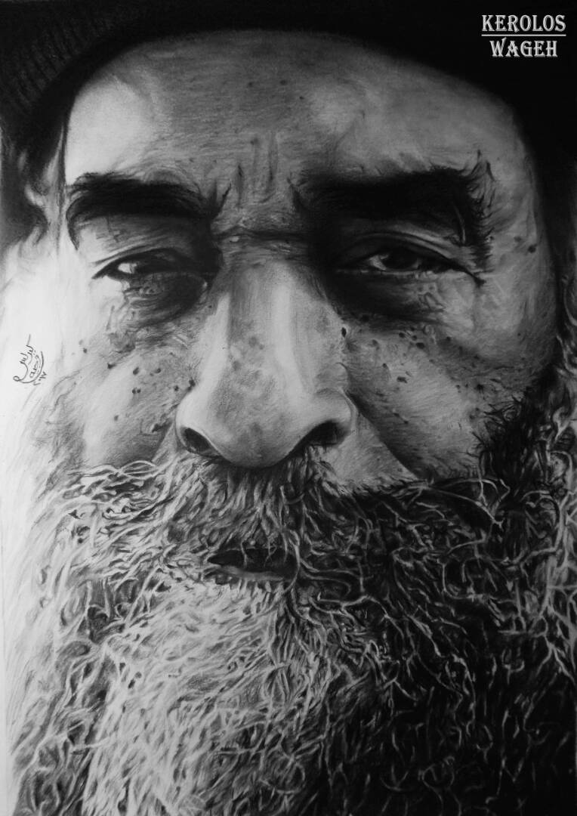
Baba…
We see this in the life of Pope Kyrillos when priests would plot against him in nefarious ways.
He would patiently accept these trials, as if from God.
Why would he we endure these trials with patience?

Slide 17
Baba…
Because when we are impatient we do not listen to what God is trying to tell us.
When we see these things as coming from other people, we are simply too agitated to listen. We are restless and angry and unsettled.
After a while, we fall into a victim mentality which seems to be a common spiritual disease of our age. Especially now, especially among young people. Everyone is a victim to someone else’s sins.

Slide 18
So why don’t we let Him in??
Scared of the consequences?
Scared to be judged?
Ashamed?
Maybe we don’t know it’s Christ??

Slide 19
See the situation, not the people…
For every one of us there is a bitter cup that the Father offers us to drink. The problem is that we have difficulty recognizing it as coming from God, since it’s usually comes from other people.
A spiritual writer says “It was not the Father's will that anyone kill his Son, nor did he inspire any one to kill him. He did will, however, that Jesus would freely be the sacrifice for the sins of mankind. He willed that Jesus would let himself be put to death.”
And then we often miss what is most essential: to accept and assent to God's will in our lives.
But it is hard, and we don't want to do it. We may know the right thing and not want to do it - this is a problem we all have, dare I say even Christ had last night in the garden.
The reason is that instead of seeing the event, we see the people behind the event.

Slide 20
There’s a story in the book of Samuel about King David….
King David was walking along and a man from Saul’s family came out and cursed him. He even pelted David and all the king’s officials with stones,
Then his guard said to the king, “Why should this dead dog curse my lord the king? Let me go over and cut off his head.”
But king David said, “What does this have to do with you? If he is cursing because the LORD said to him, ‘Curse David,’ who can ask, ‘Why do you do this?’”
Then he continued “Leave him alone; let him curse, for the LORD has told him to.”
God allows all events to happen because it is beneficial for me, somehow.
So he even took this cursing as if from God. Everything is taken from the hands of God!

Slide 21
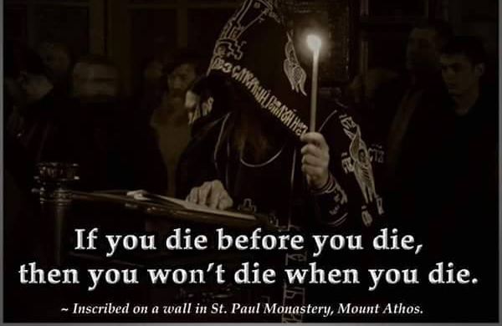
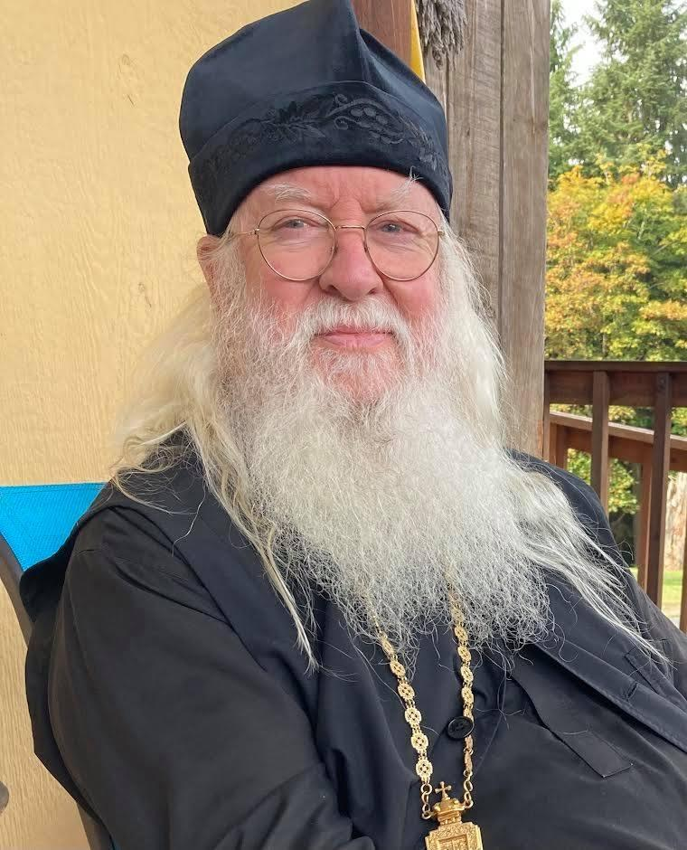
Story about Abbot Tryphon….

Slide 22
Let’s Briefly Summarize…
There are many crosses that come to us because of the evil of other people.
But let us distinguish between the person, who is doing evil, and the situation that arises that I must accept as coming from the hand of God himself.
Let us follow the words of Christ, “Abba, Father remove this cup from me; yet not what I will, but what you will” (Mk 14:36).
Let us take the cross to the path of victory and not to the path of despair, depression, victimization, blaming others, and becoming bitter.

Slide 24
Accept or Reject the Cross?
So now it’s my turn. I must use my own free will to accept what God has given me and do the right thing. How?
This is my challenge and yours. To see the cross and do the right thing.
Do some people go to the cross and do the wrong things?
On Good Friday, do we put up black or white banners all over the church?

Slide 25
Accept or Reject the Cross?
“But we preach Christ crucified, to Jews a stumbling block and to Gentiles foolishness, but to those who are the called…the power…and the wisdom of God.” 1 Cor 1:23
Is the cross a stumbling block or wisdon?
Is the cross power or foolishness?
Is the cross light or darkness?
Both.
And who gets to decide?
You do.
How? When I am faced with the cross, do I pick the right thing. To be patient, meet, humble, loving, etc.

Slide 26
This was from me… a famous letter written by saint Seraphim of Vyritsa
He sent to his spiritual child, a bishop who was in a Soviet prison at that time; this homily "This was from me" is written as a consolation and counsel to the bishop to let him know that God the Creator addresses to the soul of man.
This was from me...
Have you ever thought that everything that concerns you, concerns Me, also? You are precious in my eyes and I love you; for this reason, it is a special joy for Me to train you. When temptations and the opponent [the Evil One] come upon you like a river, I want you to know that
This was from Me.
I want you to know that when you are in difficult conditions, among people who do not understand you, and cast you away, This was from Me.
I am your God, the circumstances of your life are in My hands; you did not end up in your position by chance; this is precisely the position I have appointed for you. Your environment, and those who are around you, are performing My will. Do you have financial difficulties and can just barely survive? Know that This was from Me.
Have you ever spent the night in suffering? Did your friend or someone to whom you opened your heart, deceive you? This was from Me.

Slide 27
This was from me… a famous letter written by saint Seraphim of Vyritsa
Your plans were destroyed? Your soul yielded and you are exhausted? This was from Me.
Unexpected failures found you and despair overcame your heart, but know That this was from Me.
Serious illness found you, which may be healed or may be incurable, and has nailed you to your bed. This was from Me.
You were dreaming about doing something special for Me and, instead of doing it, you fell into a bed of pain. This was from Me.
Remember always that every difficulty you come across, every offensive word, every slander and criticism, every obstacle to your works, which could cause frustration and disappointment, This is from Me.
Know and remember always, no matter where you are, That whatsoever hurts will be dulled as soon as you learn In all things, to look at Me. Everything has been sent to you by Me, for the perfection of your soul. All these things were from Me.

Slide 28
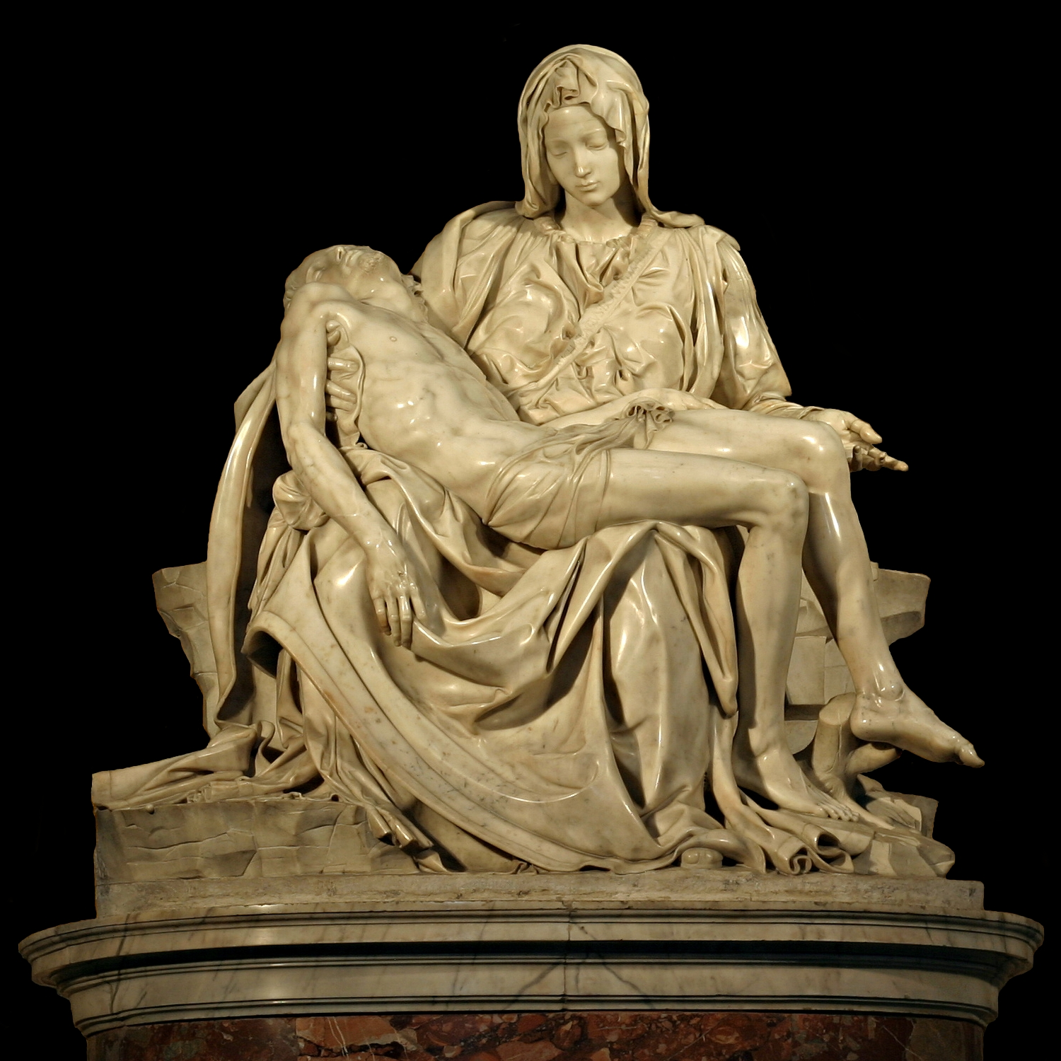
Why is this happening??
It’s like the sculptor who chisels away at us. The bad parts…
“Another few days, and life will break through” --Michael Angelo
Christ sees us. And he is chiseling away the old man, and the new man comes through.

Slide 29
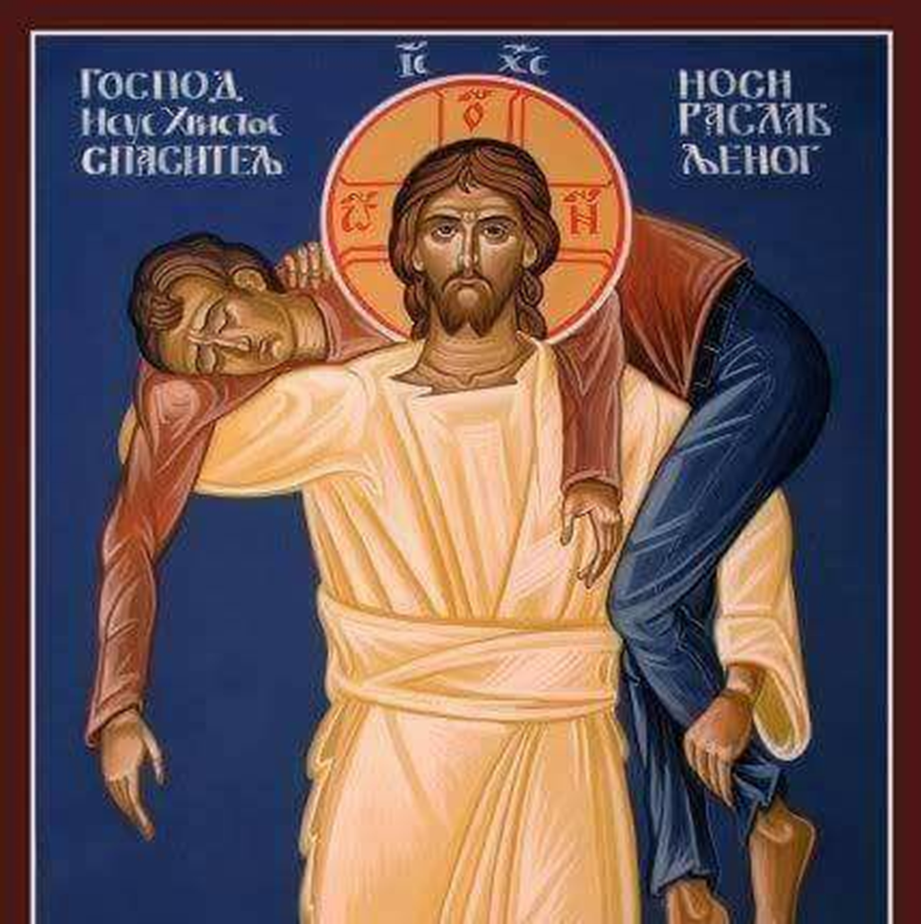
St. John Cassian
St. John Cassian describes this interplay between man and God’s work, “For it is foolish, if, when for example, we see a farmer taking the utmost pains over the cultivation of the ground, we do not ascribe the fruits to his exertions.”
So clearly the farmer did work. But now the farmer must recognize that He didn’t do it alone.
St. John continues, “For neither can the farmer, when he has worked hard in cultivating the ground, immediately ascribe the produce of the crops and the rich fruits to his own exertions, as he finds that these are often in vain unless opportune rains and a quiet and calm winter aids them”
St. John Cassisan continues “And when He sees in us some beginnings of a good will, He will immediately enlighten it and strengthen it and urge it on towards salvation, increasing that which He Himself implanted or which He sees to have arisen from our own efforts.“

Slide 30
Sirach 2…
“My child, when you come to serve the Lord, prepare yourself for testing. Set your heart right and be steadfast, and do not be hasty in time of calamity. Accept whatever befalls you, and in times of humiliation be patient. For gold is tested in the fire, and those found acceptable, in the furnace of humiliation. Trust in him, and he will help you; make your ways straight.”

Slide 31
What do we learn from the 5 loaves?
What did Christ do to the piece of bread?
He broke it.
So the Christian person in the hands of Christ is blessed and what? Broken.
He is broken to his selfishness. To his own wants, desires, cares, ego.
When he’s broken he can be distributed. Otherwise it’s just a round pita bread. He lives for himself, centered around himself and they will bury him just like that.
But the breaking hurts. It’s not just about me. My vacations. My new car. My new jewelry. My new boat. My new vacation home. My new lips or cheeks.
So who it’s about? The others. The light of the *world*. This is Christ’s goal for us. To go outside ourselves. Our selfishness and wanting things to go the way we want them to.

Slide 32
What do we learn from the 5 loaves?
Sacrifice yourself and live for others. There is no way you will bless 10 other people if you are a whole single piece.
You have to be 10 Pieces. You won’t be distributed to 10 people if you aren’t broken.
It’s painful. We are human and we love ourselves. We love to do what’s best for us and to make sure others do what is best for ourselves.
To make sure people respect us. Treat us the way we treat them. Make sure our kids are included in activities. Make sure our kids are the best.
Fr. Matthew the Poor says “Walk cautiously, patiently, humbly, know that God is at work to destroy the false you and revive the image of God who is the real you This will not happen without your permission; you can choose to be the false you the rest of your miserable life.”
If you want to have the mystery of blessing, you have to have the mystery of being broken. The mystery of dying to our own desires.

