Slide 1
Eyes to See the Spiritual World

Slide 2
Text should be in white

Slide 3
The World
physical world
“God who made the world and everything in it” Acts 17:2
2. inhabitants of the world
“Not as the world gives do I give to you” John 14:27
“If the world hates you, you know that it hated Me before it hated you.” John 15:18

Slide 4
The World
3- worldly affairs
“Do not love the world or the things in the world.”

Slide 5
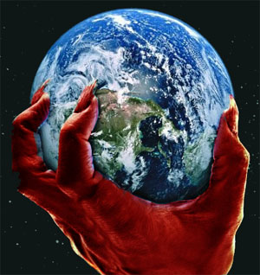
There is a spiritual world order governed behind the scenes by Satan

Slide 6
1 John 5:19
“We know that we are of God, and the whole world lies under the sway of the wicked one.”

Slide 7
” Ephesians 4:17-19
“ This I say, therefore, and testify in the Lord, that you should no longer walk as the rest of the Gentiles walk, in the futility of their mind, ¹⁸ having their understanding darkened, being alienated from the life of God, because of the ignorance that is in them, because of the blindness of their heart; ¹⁹ who, being past feeling, have given themselves over to lewdness, to work all uncleanness with greediness.

Slide 8
What are the things of that make up the world?

Slide 9
2 Corinthians 4:3-4
“And even if our gospel is veiled, it is veiled to those who are perishing. ⁴ The god of this age has blinded the minds of unbelievers, so that they cannot see the light of the gospel that displays the glory of Christ, who is the image of God.”

Slide 10
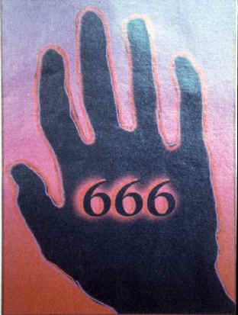
Satan is using the things of the world to lead everything to the kingdom of the antichrist

Slide 11
1 John 4:3
“and every spirit that does not confess that^{[a]} Jesus Christ has come in the flesh is not of God. And this is the spirit of the Antichrist, which you have heard was coming, and is now already in the world.”

Slide 12
2 Thessalonians 2:9-10
“The coming of the lawless one is according to the working of Satan, with all power, signs, and lying wonders, ¹⁰ and with all unrighteous deception among those who perish, because they did not receive the love of the truth, that they might be saved.”

Slide 13
How do identify the world in my life?
It can be anything that distracts you from God or causes you to put the things of God on the back burner of your life

Slide 14
1 John 2:15-16
“Do not love the world or the things in the world. If anyone loves the world, the love of the Father is not in him. ¹⁶ For all that is in the world—the lust of the flesh, the lust of the eyes, and the pride of life—is not of the Father but is of the world.”

Slide 15
James 4:4
“Do you not know that friendship with the world is enmity with God? Whoever therefore wants to be a friend of the world makes himself an enemy of God.”

Slide 16
1 John 2:16
“For all that is in the world—the lust of the flesh, the lust of the eyes, and the pride of life—is not of the Father but is of the world. ways that the devil draws to love the world:”

Slide 17
3 ways the devil draws you to perceive world the way he wants you to

Slide 18
Lust of the flesh
“The lamp of the body is the eye. If therefore your eye is good, your whole body will be full of light. ²³ But if your eye is bad, your whole body will be full of darkness. If therefore the light that is in you is darkness, how great is that darkness!” Matthew 6:22-23

Slide 19
The Lust of the Eyes
"You have made us for yourself, O Lord, and our heart is restless until it rests in you."
St Augustine

Slide 20
The Pride of Life
“For God knows that in the day you eat of it your eyes will be opened, and you will be like God, knowing good and evil.”
Genesis 3:5

