Slide 1
If You Build It, He Will Come
December 31, 2010

Slide 2
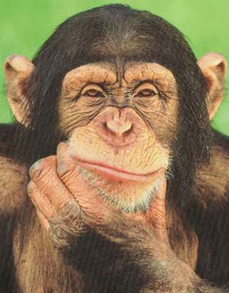
What Do I Want in 2011?

Slide 3
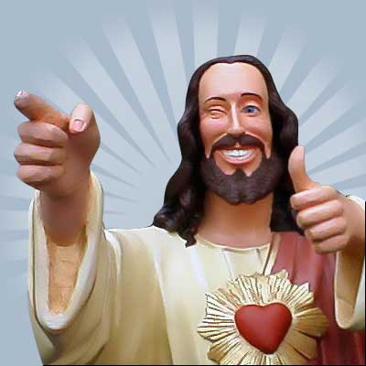
What Do I Want in 2011?
THE PRESENCE OF GOD

Slide 4
What Do I Want in 2011?
THE PRESENCE OF GOD
Omni-Presence
Indwelling Presence
Manifest Presence

Slide 5
God’s desire has always been to have COMMUNION/FELLOWSHIP with man
[that’s you!]

Slide 6
God’s desire has always been to have COMMUNION/FELLOWSHIP with man
[that’s you!]
“He who eats My flesh and drinks My blood abides in Me, and I in him.” John 6:56

Slide 7
God’s desire has always been to have COMMUNION/FELLOWSHIP with man
[that’s you!]
“Behold, the tabernacle of God is with men, and He will dwell with them, and they shall be His people. God Himself will be with them and be their God.” Revelation 21:3

Slide 8
Genesis 1:26-31
Then God said, “Let Us make man in Our image, according to Our likeness; let them have dominion over the fish of the sea, over the birds of the air, and over the cattle, over all the earth and over every creeping thing that creeps on the earth.” So God created man in His own image; in the image of God He created him; male and female He created them. Then God blessed them, and God said to them, “Be fruitful and multiply; fill the earth and subdue it; have dominion over the fish of the sea…

Slide 9
Genesis 1:26-31
…over the birds of the air, and over every living thing that moves on the earth.” And God said, “See, I have given you every herb that yields seed which is on the face of all the earth, and every tree whose fruit yields seed; to you it shall be for food. Also, to every beast of the earth, to every bird of the air, and to everything that creeps on the earth, in which there is life, I have given every green herb for food”; and it was so. Then God saw everything that He had made, and indeed it was very good.”

Slide 10
INSERT VIDEO HERE AND DELETE THIS SLIDE

Slide 11
Someone is looking for you…
“And they heard the sound of the Lord God walking in the garden in the cool of the day, and Adam and his wife hid themselves from the presence of the Lord God among the trees of the garden. Then the Lord God called to Adam and said to him, Where are you?” Genesis 3:8-9

Slide 12
2011 Goal: Build Him a Home
“Then have them make a sanctuary for me, and I will dwell among them.” Exodus 25:8

Slide 13
Matthew 22:10-12
“So those servants went out into the highways and gathered together all whom they found, both bad and good. And the wedding hall was filled with guests. But when the king came in to see the guests, he saw a man there who did not have on a wedding garment. So he said to him, ‘Friend, how did you come in here without a wedding garment?’ And he was speechless.”

Slide 14
Matthew 22:14
“For many are called, but few are chosen.”

Slide 15
Gaining & Maintaining

Slide 16
Gaining & Maintaining
Gaining requires holiness
“Pursue peace with all people, and holiness, without which no one will see the Lord” Hebrews 12:14
“The Holies are for the holy”

Slide 17
Gaining & Maintaining
Gaining requires holiness, which comes by being honest about my true state
“Surely You desire truth in the inner parts and wisdom in the inmost place.” Psalm 51:6

Slide 18
Gaining & Maintaining
Gaining requires holiness, which comes by being honest about my true state
“For I am persuaded that neither death nor life, nor angels nor principalities nor powers, nor things present nor things to come, nor height nor depth, nor any other created thing, shall be able to separate us from the love of God which is in Christ Jesus our Lord.” Romans 8:38-39

Slide 19
Gaining & Maintaining
Gaining requires holiness, which comes by being honest about my true state
RESOLUTION FOR 2011:
Regular time of honest examination

Slide 20
Haggai 1:2-8
“Thus speaks the LORD of hosts, saying: ‘This people says, “The time has not come, the time that the LORD’s house should be built.”’
Then the word of the LORD came by Haggai the prophet, saying, “Is it time for you yourselves to dwell in your paneled houses, and this temple[a]to lie in ruins?” Now therefore, thus says the LORD of hosts: “Consider your ways!”

Slide 21
Haggai 1:2-8
“You have sown much, and bring in little;
You eat, but do not have enough;
You drink, but you are not filled with drink;
You clothe yourselves, but no one is warm;
And he who earns wages,
Earns wages to put into a bag with holes.”
Thus says the LORD of hosts: “Consider your ways! Go up to the mountains and bring wood and build the temple, that I may take pleasure in it and be glorified,” says the LORD.

Slide 22
Gaining & Maintaining
Maintaining requires a life of prayer

Slide 23
Luke 11:9-13
“So I say to you, ask, and it will be given to you; seek, and you will find; knock, and it will be opened to you. For everyone who asks receives, and he who seeks finds, and to him who knocks it will be opened. If a son asks for bread from any father among you, will he give him a stone? Or if he asks for a fish, will he give him a serpent instead of a fish? Or if he asks for an egg, will he offer him a scorpion? If you then, being evil, know how to give good gifts to your children, how much more will your heavenly Father give the Holy Spirit to those who ask Him!”

Slide 24
Gaining & Maintaining
RESOLUTION FOR 2011:
Do nothing without prayer
“I will not enter my house or go to my bed, I will allow no sleep to my eyes or slumber to my eyelids, till I find a place for the LORD, a dwelling for the Mighty One of Jacob.” Psalm 132:3-5

Slide 25
Who’s Ready to Build?

Slide 26
Who’s Ready to Build?
“Seek the LORD while He may be found,
call upon Him while He is near.”
Isaiah 55:6

