Slide 1
Orthodox Recovery from Substance use
St. Mary’s East Brunswick, 12/8/2019

Slide 2
Our aim today
1) understand the nature of addiction
2) understand strategies for speaking with someone struggling through it and what our role is in the process
3) understand how to connect someone to professional help

Slide 3
HELP!
I prayed, took meds, and love my mom!
I’m DYING
Sin- Have more Faith & Pray!
Disease- Take your MEDS!
Psychological Defect-
Tell me about your mother!
Notes:
Poll – Sin Disease Psychological Defect
All 3
Disease model really emphasized 1970-present
Spiritual aspects get renewed focus 1995-now
CAUSES? It is really all 3 and we are going to show how and why
If we are all Christians, why do we struggle. Abundant Living
We look at all 3 spheres separately. The answer involves looking at all 3

Slide 4
Sin?
Disease?
ADDICTION
Personality Defect?
Notes:
Poll: Disease/Biological/Genetic Psychological/Personality/Will Sin/Moral/Spiritual
Disease model really emphasized 1970-present
Spiritual aspects get renewed focus 1995-now

Slide 5
A distinction…
20 But you, beloved, building yourselves up on your most holy faith, praying in the Holy Spirit, 21 keep yourselves in the love of God, looking for the mercy of our Lord Jesus Christ unto eternal life.
22 And on some have compassion, making a distinction; 23
but others save with fear, pulling them out of the fire, hating even the garment defiled by the flesh.
Jude 20-22

Slide 6
How common are substance use disorders?
Alcohol use
~30% Americans ≥18 years old exceed recommended limits
Smaller percentage have alcohol use disorder
Illicit drugs
~9% Americans ≥12 years use
Marijuana (7.5%)
Prescription drugs (2.5%, mostly opioids), Heroin (0.1%)
Cocaine (0.6%), Hallucinogens (0.5%), Inhalants (0.2%)
Notes:
How common are substance use disorders? Alcohol use and other substance use disorders, excluding tobacco, contribute to more than 90 000 deaths in the United States annually (3). Despite such dire consequences, these conditions are often inadequately addressed in outpatient care. And yet, substance use disorders have much in common with other medical conditions that are commonly treated in primary care and other medical settings: genetic, environmental and behavioral roots; enduring biological changes that lead to a chronic, relapsing and remitting course; and response to both medical and behavioral treatment (4).
Alcohol use disorders remain the most common substance use disorder in the United States. Nearly 30% of Americans 18 years of age or older exceed recommended limits for alcohol consumption and can be considered “at-risk” or “risky” drinkers (5). Fewer, but still a substantial minority, have consumption patterns indicative of an alcohol use disorder (AUD). The 12-month and lifetime prevalences of AUD among adults in the United States are 14% and 29%, respectively (6).
Approximately 22.3 million Americans aged 12 years or older were current users of illicit drugs in 2013, representing 9.4% of that population. According to the 2013 National Survey on Drug Use and Health, marijuana was by far the most commonly used drug (7.5%), followed in descending order by prescription drugs (2.5%, most of which are opioids), cocaine (0.6%), hallucinogens (0.5%), inhalants (0.2%), and heroin (0.1%) (7). Of note, prescription opioid use disorders in the United States are increasing and seem to be a gateway to heroin use, which is both cheaper and more abundant in some parts of the country. One consequence is an epidemic of opioid overdoses, with those involving prescription opioids increasing 3-fold, and heroin overdoses increasing 5-fold from 2001 to 2013 (8). Methamphetamine (“crystal meth”), use of which has declined slightly, is uncommon on a population level but remains a major problem in some regions of the country. In addition, concern about designer drug use among young adults is increasing; these drugs include synthetic cannabinoids (also known as K2 or “spice”), which were used more commonly than any drug except cannabis among high school seniors in 2013, and substituted cathiones including mephredone or “bath salts” (9).

Slide 7
Addiction is a major public health concern….
Annual Costs
Obesity – 147 billion
Smoking – 157 billion
Diabetes – 174 billion
Addiction – 193 billion*
Heart Disease – 316 billion
Mental Illness – 100 billion
*2011 ONDCP report: The Economic Impact of Illicit Drug Use on American Society
Notes:
In 2007, the cost of illicit drug use totaled
more than $193 billion.1 Direct and indirect
costs attributable to illicit drug use are estimated
in three principal areas: crime, health,
and productivity
As you can see the societal costs of addiction are on par with most other major health concerns in the US.

Slide 8
May not talk to anyone about it but you!
Illnesses such as a variety of cancers, risk for osteoarthritic fracture, sleep disorders, and general medication adherence are negatively related to greater quantity and frequency of alcohol consumption
Yet more than 80 percent of adults say they've never discussed alcohol use with a health professional, a survey finds.
(CDC Morbidity and Mortality Weekly Report (MMWR)
Notes:
Drinking four or more drinks per day has a negative effect on diabetes, hypertension and possibly depression.
The last CDC report indicated that only 15% of adults have ever had a discussion with their healthcare providers around alcohol.

Slide 9
Treatment of Co Occurring Mental Health and Substance Abuse – (Less than 10% receive it*)
2.6 million adults had co-occurring SMI and substance use disorder.
Only 7.4 percent of individuals receive treatment for both conditions with 55.8 percent receiving no treatment at all.
* National Survey of Drug Use and Health (NSDUH 2012)

Slide 10
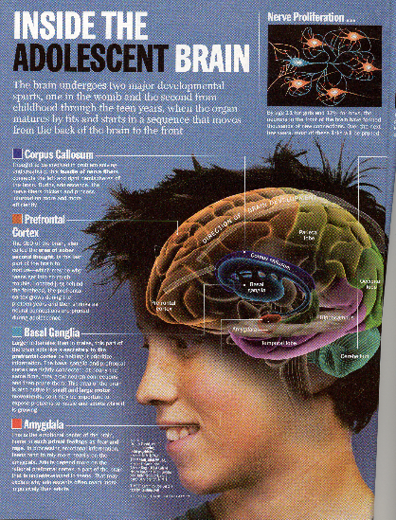
What We Now Know
Adolescence is a critical period in brain development.
The brain is still developing until approximately age 24 or 25
Slide courtesy of Ken Winters, PhD.
Notes:
But thankfully, we truly now know much more about the functioning and development of the brain than what that graphic depicts.
Thanks to technology like fMRI (Functional magnetic resonance imaging), we now can see which parts of the brain are active at different periods of a person’s life. Initially we thought that because the human brain tends to reach its full size by age 10yo, it was fully developed at that time. However, we now know that the full development of neural connections within the brain doesn’t happen until age 24 or 25, and that adolescence is a critical period when a significant amount of that development is happening.
Get to talking about used to think that at age 10, when brain reaches the same size as an adult brain, that full maturation had been met.
Adolescence is a time of critical brain development, especially in the parts of the brain needed for complex tasks, organization, planning and judgment.

Slide 11
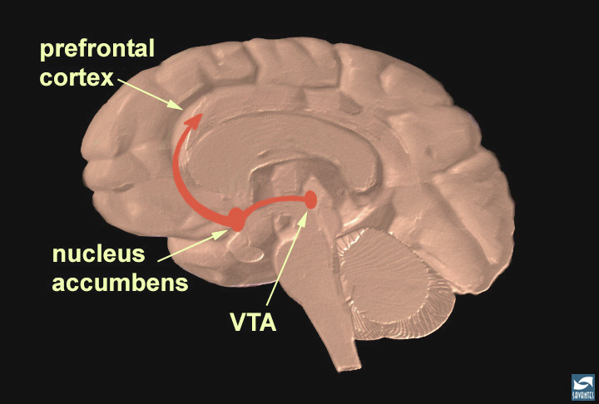
The Reward Pathway
Ventral-Tegmental
Area
Source: NIDA
Notes:
So, remember we talked about the limbic system (amygdala, hippocampus), nucleus accumbens and prefrontal cortex are all developing during adolescence.
These components also make up an area in the brain that is called the reward pathway. This is a system of the brain that drives motivation, reward, and behavior. It’s function is to remind us to do the important things for survival (e.g. eating, reproduction). The way that it reminds us is by creating rewards (such as pleasure) for doing those things.
It’s operations are dependent on two neurotranmitters, dopamine and seratonin.
[VTA = Ventral Tegmental Area]
Nucleus accumbens
Located in the striatum, right next to the septum of the limbic system
-Main output type of neuron in NA produces GABA, cells output to the prefrontal cortex, striatum, substantia nigra
- Major input to NA include amygdala, prefrontal association cortices, and dopaminergic neurons in the VTA. Dopaminergic input from VTA modulates activity of NA neurons causing major increase in dopamine levels in the NA. Almost all substances of abuse shown to increase dopamine levels in the NA.
ALL SUBSTANCES OF ABUSE ACT ON THE REWARD PATHWAY, AMONG OTHER areas.

Slide 12
marijuana
Notes:
Addictive substances, when introduced into the brain, have an impact on neurotransmission. You can see in this slide that different substances effect neurotransmission in various areas of the brain (as indicated by the yellow dots). However, they all end up causing the NA to have a flood of dopamine, which gives us that “high,” while seratonin secretion is decreased, keeping us feeling both like we can never have enough of the substance and disinhibited towards getting more of it.
In the human brain, THC has been found to increase dopamine release in the reward pathway, just like every other addictive drug. The reward pathway in the brain evolved to give us pleasure when we do the things that help our species survive – eating, sex, spending time with the ones we love. Addictive drugs give “counterfeit” pleasure.
Yellow dots indicate where different addiction substances have effects on neurotransmission, which vary but which all cause the NA to have a flood of dopamine, which then acts on NA neuron output to other parts of brain.

Slide 13
Why does this happen
Genetic polymorphisms
May contribute 40% to 60% of an individual’s risk
Environmental factors in childhood or adolescence
Age of first exposure to alcohol or drugs
Adverse childhood experiences
Psychiatric comorbidities
Depression, anxiety, bipolar disorder
May contribute to vulnerability to addiction
Anxiety and depressive symptoms may be a consequence of long-term substance use
Notes:
What are the risk factors?
Studies suggest that genetic polymorphisms may contribute to as much as 40% to 60% of an individual's risk for addiction (10, 11). Environmental factors in childhood or adolescence may also be particularly important, including age of first exposure to alcohol or drugs (12) and adverse childhood experiences (13). Finally, substance use disorders are commonly associated with psychiatric comorbidities, including depression, anxiety, and bipolar disorder. These conditions may contribute to an individual's vulnerability to addiction; in addition, anxiety and depressive symptoms may be a consequence of long-term substance use.

Slide 14
This is bad…
Is there a way we can actually MOTIVATE people to change?

Slide 15
What is Motivational Interviewing?
It is:
A style of talking with people constructively about reducing their health risks and changing their behavior.
Notes:
Draw from audience the kinds of changes that they would like to see individuals they know make. Inquire as to whether they have talked with them about making the changes and what the results were.

Slide 16
What is Motivational Interviewing?
It is designed to:
Enhance one’s own motivation to change using strategies that are empathic and non-confrontational.
Notes:
Do exercise where participants work with one other person. Each person chooses a behavior they think would be helpful for them to make but that they have not yet successfully changed. Have partners take turns talking with the other person about making that change.
Instruct the convincing partner to point out all the reasons the person should change, offer suggestions for them to change, warn them about what may happen if they don’t change, etc.
Process with group how it felt to have someone interact with them in such a confrontational way. How did it make them feel about changing?

Slide 17
MI - The Spirit: Style
Nonjudgmental and collaborative
Based on consumer and clinician partnership
Gently persuasive
More supportive than argumentative
Listens rather than tells
Communicates respect and acceptance for consumers and their feelings

Slide 18
MI - The Spirit
Responsibility for change is left with the person (not you)
Change arises from within rather than being imposed from without
Emphasis on consumer’s personal choice for deciding future behavior
Focus on eliciting the consumer’s own concerns

Slide 19
Ambivalence
All change contains an element of ambivalence.
We “want to change and don’t want to change”
Patients’ ambivalence about change is the “meat” of the brief intervention.
Notes:
Note: This slide contains automatic animation. As you are reviewing the bullet points the image of the woman should advance automatically to demonstrate a variety of different emotions. Participants may chuckle or become slightly distracted by the images. They are very effective in making the point about ambivalence.
The first thing to recognize with change is that we all have feelings of ambivalence.
What is ambivalence? It’s when we feel two ways about something. We may like to drink, but we also don’t like having a hangover. Exploring a person’s ambivalence about change is one way of assessing where they are in the change process.
An individual’s ambivalence about taking action is rich material that we can use as the basis for the brief intervention. If we can get an individual to talk about his or her ambivalence about making a change, we gain access into their world and can better understand their perspective.

Slide 20
How does MI differ from traditional or typical medical counseling?
AMBIVALENCE is the key issue to be
resolved for change to occur.
People are more likely to change when they hear their own discussion of their ambivalence.
This discussion is called “change talk”
in MI.
Getting patients to engage in “change talk” is a critical element of the MI process.
*Glovsky and Rose, 2008

Slide 21
How to Explore Ambivalence
The good things about ______
The not- so-good things about ____
The good things about changing
The not-so-good things about changing
Avoid questions that inspire a yes/no answer.
Notes:
The way we explore ambivalence in motivational interviewing is to ask open-ended questions.
Use pointer to direct attention to related boxes
Upper Left: For example, “What are the good things about your substance use?”
Upper Right: “What about the not-so-good things?”
Lower Left: “What would be good about using less?”
Lower Right: “What would be not so good about cutting back?”
Someone tell me if this is an open or a closed question, “Do you drink when you are alone?”
Elicit responses. Correct answer: This is a closed question.
How could you make it an open-ended question?
Suggestion: Who do you drink with on a typical day?

Slide 22
Motivational Interviewing Strategies
Use reflective listening and empathy
Avoid confrontation
Explore ambivalence
Elicit “change talk”
Notes:
Motivational interviewing strategies help raise awareness and enhance motivation. Reflective listening, showing empathy, avoiding confrontation, exploring ambivalence, and eliciting change talk are core strategies. Let’s take a look at a couple videos that demonstrate a motivational interviewing style.

Slide 23
Building Motivation OARS (the micro-skills)
Open-ended questioning
Affirming
Reflective listening
Summarizing

Slide 24
Affirmations
Reflect back statements to the person that
acknowledges a person’s strengths, efforts
& hopefulness.
Affirm the change behaviors
“You’re the kind of person who…”
Notes:
Patience—sitting in medicaid office
Determination – to get it done
Resilient=survivor
Begini=ning of Engagement Stage: 2-3 affirmations and then reflection

Slide 25
Reflections
Simple Reflection: Repeat of what the person said, maybe
changing one word, but basically inferring nothing
Paraphrase or Complex Reflections: Capture the meaning and emotion of what was said and possibly add something that was implied though not said. Worker makes inferences
Amplified Reflection
Double sided Reflection
Reframing
Reflection of Feeling
Continuing the Paragraph
Metaphor or Simile
Reflection of feeling
Summarization
Notes:
Paraphrase or Complex reflections name that which is “in the air” in the intersubjective field.

Slide 26
Descriptions of Reflections
Simple Reflection: Repeat of what person said, maybe
changing one word, but basically inferring little
“Drinking relaxes me.” -→ “Drinking alcohol lowers anxiety”
Amplified Reflection: The content offered by the person is
exaggerated, over stated, increased in intensity or otherwise
stated in a manner that amplifies it with the hope the person will
see another perspective
“I don’t know why everyone is making such a big deal about my
having a few drinks now and then.”
Example- “Everyone around you gets absolutely loses it over you rarely drinking”
Notes:
Simple: “Drinking alcohol lowers anxiety”
Amplified Reflection: “Everyone around you gets absolutely loses it over you rarely drinking”
Another example:
“It sounds like your psychiatrist can’t hear any of what you have to say.”

Slide 27
Reflections Cont
Double sided: Both sides of the ambivalence are reflected in a single response. Structured as: “On the one hand this…and on the other hand that..”
“I like to go out with my friends to get away from my abusive parents.”
In a previous discussion, person states, “I’m really scared that my friends will get me arrested.”
→ So on the one hand you want to get away from your home environment, but you’re also worried that your friends may put you in a tough spot.
Reframing: suggest a more positive meaning for a
negative interpretation expressed by the person. This actually
changes the meaning, does not just deepen it
“Everyone just wants me to go to rehab!”
Example: it sounds like people around you feel that rehab would be really helpful.
Notes:
Double sided: “on the one hand you would like to be with your boyfriend as often as possible, on the other hand you are afraid he will hit you.”
Reframing: Your family and caseworker would like you to manage your symptoms with psychiatric medications”
Reframing: “It sounds like right now you are finding K2 to be more helpful for you than staff support”

Slide 28
Avoid Confrontation
Challenging
“What do you think you are doing?”
Warning
“You will damage your liver if you don’t stop drinking.”
Finger-wagging
“If you want to be a good student, you must stop drinking on school nights.”
Notes:
Confrontation is counterproductive to enhancing people’s motivation to change. When we confront people about their substance use, we are arguing with them, or trying to convince them that they have a problem. Arguing with our patients is going to make them defensive, which is the opposite of what we want to accomplish during a brief intervention.
Bullet 1. When we confront people we can challenge them, “What do you think you are doing?”
Bullet 2. Warn them, “You are going to damage your liver.”
Bullet 3. And tell them what to do, “If you want to be a good student, you must stop drinking on school nights.”
What other types of confrontational statements could we make when talking to someone about their substance use?
Elicit a few responses from participants.
Note: Other ways of confronting someone include moralizing, giving unwanted advice, shaming, and being sarcastic.

Slide 29
Elicit “Change Talk”
Change talk consists of self-motivational statements that suggest:
Recognition of a problem
Concern about staying the same
Intention to change
Optimism about change
Notes:
Another key strategy in motivational interviewing is eliciting change talk.
Change talk consists of self-motivational statements that people make in relation to behavior change.
Bullet 1. Patients may say things that suggest they recognize the problem,
Bullet 2. have concerns about not changing,
Bullet 3. have some intention to change, and
Bullet 4. feel optimistic about their ability to make change.
When patients make these statements, they are moving in the direction of being more willing or motivated to change.

Slide 30
1. Precontemplation
Definition:
Not yet considering change or
is unwilling or unable to change.
Primary Task:
Raising Awareness
6. Recurrence
Definition:
Experienced a recurrence
of the symptoms.
Primary Task:
Cope with consequences and
determine what to do next
2. Contemplation
Definition:
Sees the possibility of change but
is ambivalent and uncertain.
Primary Task:
Resolving ambivalence/
Helping to choose change
Stages of Change: Primary Tasks
5. Maintenance
Definition:
Has achieved the goals and is
working to maintain change.
Primary Task:
Develop new skills for
maintaining recovery
3. Determination
Definition:
Committed to changing.
Still considering what to do.
Primary Task:
Help identify appropriate
change strategies
4. Action
Definition:
Taking steps toward change but
hasn’t stabilized in the process.
Primary Task:
Help implement change strategies
and learn to eliminate
potential relapses
Notes:
The Stages of Change is a theoretical perspective that we can use to understand where a person is coming from in terms of their substance use. At the top in blue is the first stage called precontemplation. At this stage people do not see a problem with their use and are not considering change.
Use the pointer so participants can follow along on screen.
The stages that follow are contemplation, determination, action, maintenance, and recurrence.
Contemplation is a stage that we strive to move patients to if they are at risk for substance use related problems. Patients in the contemplation stage can see the possibility of change, but they are ambivalent about changing. The determination stage is where we begin to identify strategies for change. Action is where changes are taking place. Maintenance is where patients have achieved their goal and are working to maintain their new behaviors. Recurrence is when patients may relapse or go back to their old behaviors. Recurrence is part of the process of changing.

Slide 31
Stages of Change: Intervention Matching Guide
Offer factual information Explore the meaning of events that brought the person to treatment Explore results of previous efforts Explore pros and cons of targeted behaviors | Explore the person’s sense of self-efficacy Explore expectations regarding what the change will entail Summarize self-motivational statements Continue exploration of pros and cons | Offer a menu of options for change Help identify pros and cons of various change options Identify and lower barriers to change Help person enlist social support Encourage person to publicly announce plans to change
Support a realistic view of change through small steps Help identify high-risk situations and develop coping strategies Assist in finding new reinforcers of positive change Help access family and social support | Help identify and try alternative behaviors (drug-free sources of pleasure) Maintain supportive contact Help develop escape plan Work to set new short and long term goals | Frame recurrence as a learning opportunity Explore possible behavioral, psychological, and social antecedents Help to develop alternative coping strategies Explain Stages of Change & encourage person to stay in the process Maintain supportive contact
1. Pre- contemplation
2.
Contemplation
3.
Determination
4.
Action
5.
Maintenance
6.
Recurrence
Notes:
This chart shows what strategies we can employ with patients at the different stages of readiness to change. If we look at the first two stages—which are most relevant for people engaging in at-risk levels of substance use—we can see that our goals are just to offer information or feedback, explore the meaning of events, explore pros and cons of substance use, and build self-efficacy.
Patients may not be ready to make a change at the time of this brief intervention. However, they may be willing to explore the pros and cons of their use, or track levels of use to see if they may have a more significant problem than they realized. By linking the interventions to where they are in the stages of change, we can help to move them forward in the stages and increase the likelihood that they will take action.
If we get ahead of them (ask them to take action before they have identified that they even have a problem), we are likely to stimulate resistance.

Slide 32
What if it works
Resources

Slide 33
Resources to consider
Medication assisted treatment- There is an affective medication to treat alcohol, marijuana, heroin, prescription drugs.
Inpatient detox program
Inpatient rehab
Residential treatment

Slide 34
How do I find these
findtreatment.samhsa.gov
Psychology today
The individual insurance Company
Your role is vital

Slide 35
Brain images

Slide 36
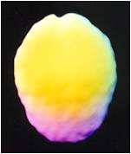
Normal Brain-Top
Copyright 2013 - Lighthouse Network

Slide 37
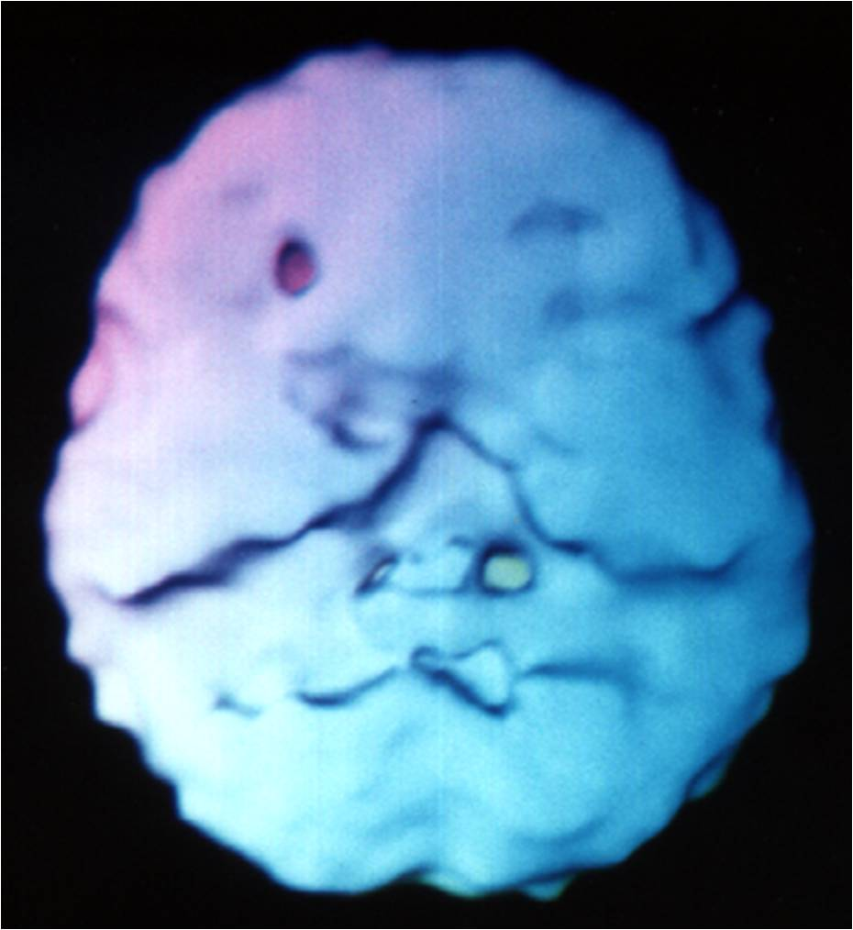
Normal Brain-Bottom
Copyright 2013 - Lighthouse Network

Slide 38
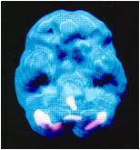
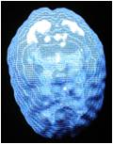
Normal Brain-Active Views
Copyright 2013 - Lighthouse Network

Slide 39
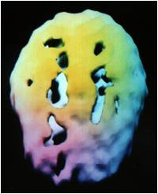
Motorcycle Accident
Copyright 2013 - Lighthouse Network

Slide 40
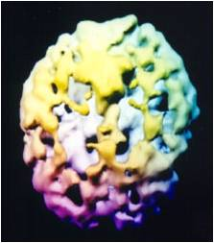
25 year Heroin Addiction - 39 yo
Copyright 2013 - Lighthouse Network

Slide 41
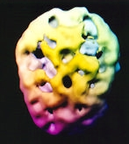
10 yr Heroin then 7 yr Methadone - 40 yo
Copyright 2011 - Lighthouse Network

Slide 42
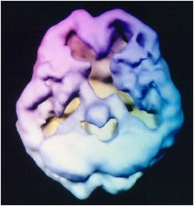
16 Years of Daily THC (Tetrahydrocannibinol) Use 32 yo
Copyright 2013 - Lighthouse Network

Slide 43
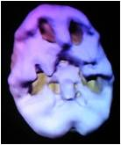
2 Years of Daily Marijuana Abuse - 16 yo
Copyright 2013 - Lighthouse Network

Slide 44
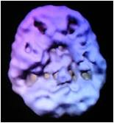
10 Years of Mostly Weekend Marijuana Use 28 yo
Copyright 2013 - Lighthouse Network

Slide 45
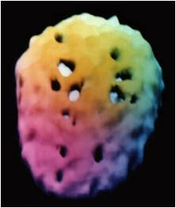
2 Years of Frequent Cocaine Use - 24 yo
Copyright 2013 - Lighthouse Network

Slide 46
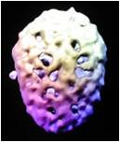
8 Years of Heavy Methamphetamine Use 28 yo
Copyright 2013 - Lighthouse Network

Slide 47
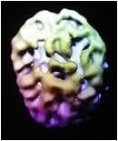
17 Years of Heavy Weekend Alcohol Use 38 yo
Copyright 2013 - Lighthouse Network

Slide 48
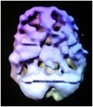
17 Years of Heavy Weekend Alcohol Use 38 yo
Copyright 2013 - Lighthouse Network

Slide 49
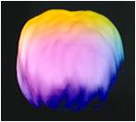
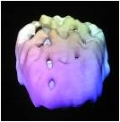
17 Years of Heavy Weekend Alcohol Use 38 yo
Copyright 2013 - Lighthouse Network

Slide 50
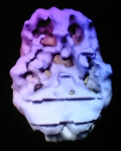
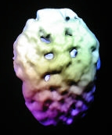
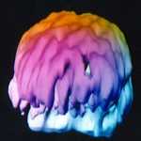
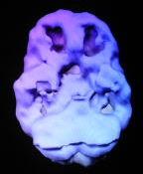
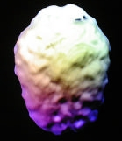
Good news! PolySubstance Abuse and then 1 yr Clean
Copyright 2011 - Lighthouse Network

Slide 51
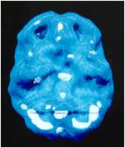
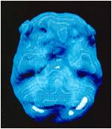
Depression
Copyright 2013 - Lighthouse Network
Before Treatment
After Treatment

