Slide 1
Examining My Heart
Eve of Thursday of the Holy Pascha

Slide 2
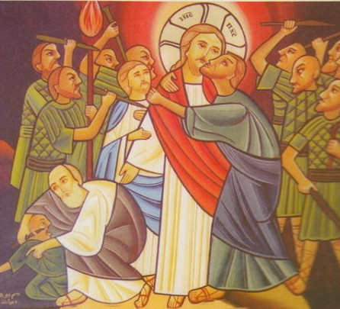
Hymn of “Avetchinon”
His words were softer than oil, Yet they were drawn swords. (Ps. 55:21)

Slide 3
1st Hour Prophecy of Wednesday
“Thus he called the name of that place Temptation and Abuse because of the abusive language of the children of Israel and because they tempted the Lord, saying, “Is the Lord among us or not?” (Exodus 17:7)

Slide 4
But when His disciples saw it, they were indignant, saying, “Why this waste? 9 For this fragrant oil might have been sold for much and given to the poor.” (Matt. 26:8,9)

Slide 5
“nor let us tempt Christ, as some of them also tempted, and were destroyed by serpents; nor complain, as some of them also complained, and were destroyed by the destroyer.” (1 Cor. 10:9,10)

Slide 6
1st Hour Prophecy of Wednesday
Trust in the Lord with all your heart and do not exalt in your own wisdom. In all your ways know wisdom, that she may cut a straight path for you and your foot will not stumble…For the profits gained from wisdom are better than the treasures of gold and silver. Wisdom is more valuable than precious stones. (Proverbs 3:5,6,14)

Slide 7
1st Hour Prophecy of Wednesday
“When Ephraim saw his sickness, And Judah saw his wound, Then Ephraim went to Assyria And sent to King Jareb; Yet he cannot cure you, Nor heal you of your wound. (Hosea 5:13)

Slide 8
6th Hour of Eve of Thursday
42 Nevertheless even among the rulers many believed in Him, but because of the Pharisees they did not confess Him, lest they should be put out of the synagogue; 43 for they loved the praise of men more than the praise of God. (John 12:42,43)

Slide 9
24 “Therefore whoever hears these sayings of Mine, and does them, I will liken him to a wise man who built his house on the rock: 25 and the rain descended, the floods came, and the winds blew and beat on that house; and it did not fall, for it was founded on the rock. 26 “But everyone who hears these sayings of Mine, and does not do them, will be like a foolish man who built his house on the sand: 27 and the rain descended, the floods came, and the winds blew and beat on that house; and it fell. And great was its fall.” (Matt 7:24-27)

Slide 10
Behold, how good and how pleasant it is For brethren to dwell together in unity! 2 It is like the precious oil upon the head, Running down on the beard, The beard of Aaron, Running down on the edge of his garments. (Psalm 133:1,2)

Slide 11
29 Abraham said to him, ‘They have Moses and the prophets; let them hear them.’ 30 And he said, ‘No, father Abraham; but if one goes to them from the dead, they will repent.’ 31 But he said to him, ‘If they do not hear Moses and the prophets, neither will they be persuaded though one rise from the dead.’” Luke 16:29-31

Slide 12
What is Christ worth to you?
Therefore, thus says the Lord: Behold, lay for the foundations of Zion a costly stone, a chosen and precious cornerstone for its foundation, and whoever believes in Him will not be put to shame. (Isaiah 28:16, 11th hour prophecy of Wednesday)

Slide 13
A little while longer the light is with you. Walk while you have the light, lest darkness overtake you; he who walks in dark- ness does not know where he is going. “While you have the light, believe in the light, that you may become sons of light.” (John 12:36, 11th hour Wednesday)

