Slide 1
The Desert and the Cell

Slide 2
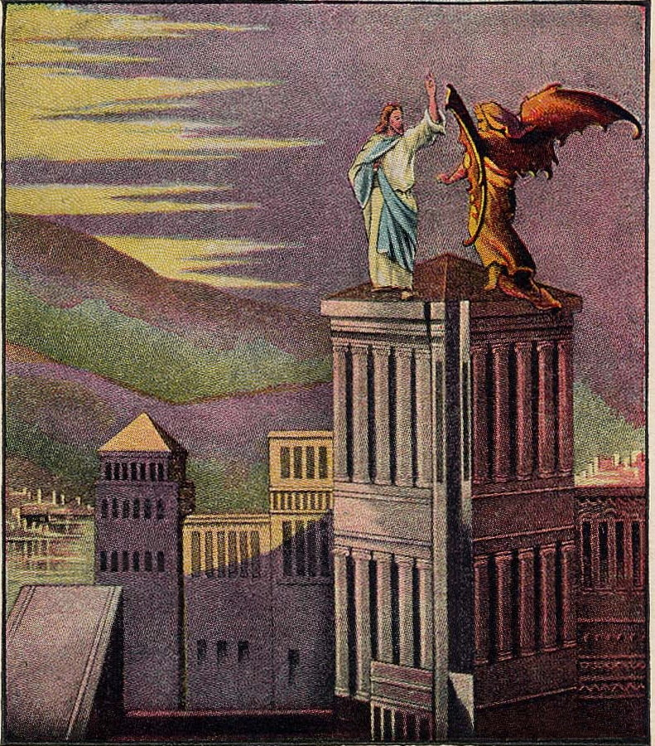
Ambrose of Milan said, “So Jesus, full of the Holy Spirit, is led into the desert for a purpose, in order to challenge the devil. If he would not fought, he would not have conquered him for me.”
He also says, “There are three things which untied together conduce to the salvation of man; The Sacrament, The Wilderness, and Fasting.

Slide 3
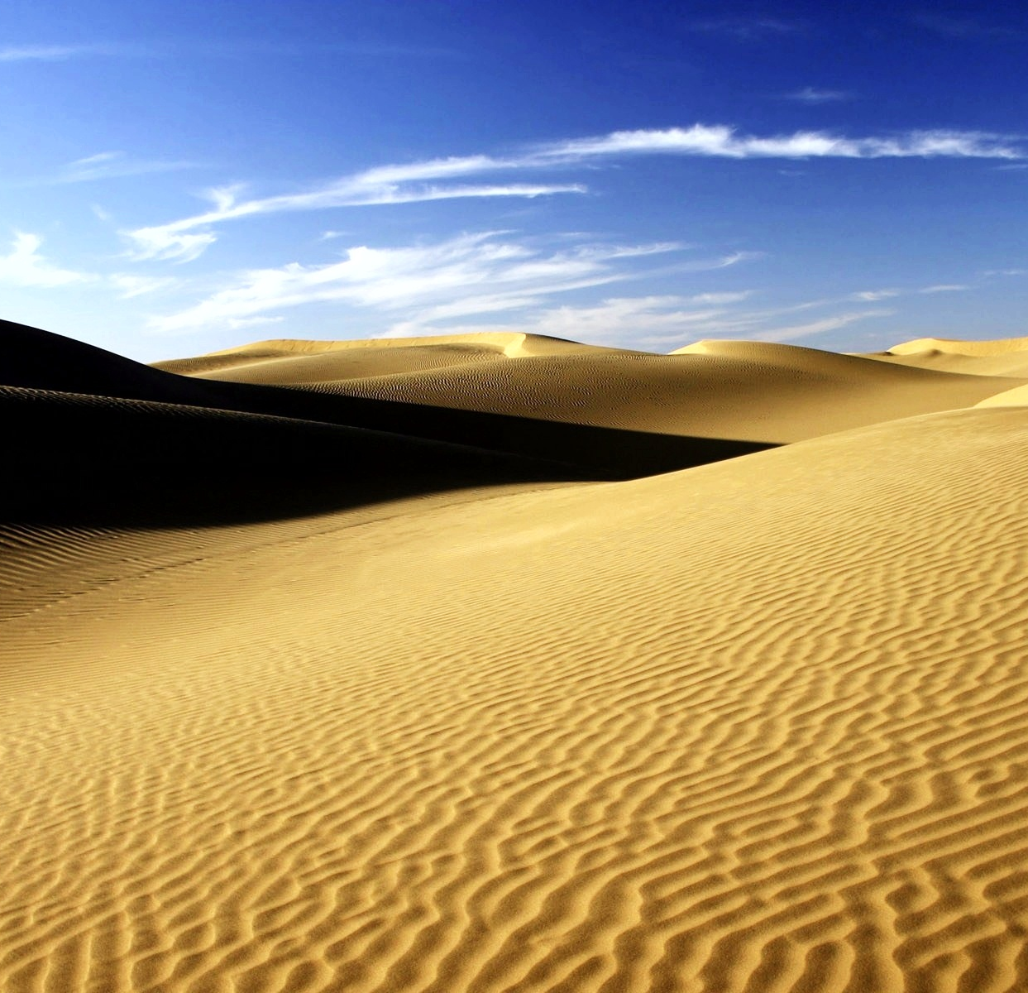
“Desert” (eremos) literally means “abandonment”
In the desert you will find no one and no thing. In the desert, you can only face up to yourself and to every aspect of your self, to your temptations, and to your reality. You confront your own heart, and your heart’s deepest desires, without any scapegoat, without any hiding place.
This Photo by Unknown Author is licensed under CC BY-NC-ND

Slide 4
Mark 7:1-8, 17-23
Then the Pharisees and some of the scribes came together to Him, having come from Jerusalem. ² Now when they saw some of His disciples eat bread with defiled, that is, with unwashed hands, they found fault. ³ For the Pharisees and all the Jews do not eat unless they wash their hands in a special way, holding the tradition of the elders.

Slide 5
. ⁴ When they come from the marketplace, they do not eat unless they wash. And there are many other things which they have received and hold, like the washing of cups, pitchers, copper vessels, and couches.

Slide 6
⁵ Then the Pharisees and scribes asked Him, “Why do Your disciples not walk according to the tradition of the elders, but eat bread with unwashed hands?”
⁶ He answered and said to them, “Well did Isaiah prophesy of you hypocrites, as it is written:
‘This people honors Me with their lips, But their heart is far from Me. ⁷ And in vain they worship Me, Teaching as doctrines the commandments of men.’
⁸ For laying aside the commandment of God, you hold the tradition of men—^{[d]}the washing of pitchers and cups, and many other such things you do.”

Slide 7
When He had entered a house away from the crowd, His disciples asked Him concerning the parable. ¹⁸ So He said to them, “Are you thus without understanding also? Do you not perceive that whatever enters a man from outside cannot defile him, ¹⁹ because it does not enter his heart but his stomach, and is eliminated, ^{[a]}thus purifying all foods?”
²⁰ And He said, “What comes out of a man, that defiles a man. ²¹ For from within, out of the heart of men, proceed evil thoughts, adulteries, fornications, murders, ²² thefts, covetousness, wickedness, deceit, lewdness, an evil eye, blasphemy, pride, foolishness. ²³ All these evil things come from within and defile a man.”

Slide 8
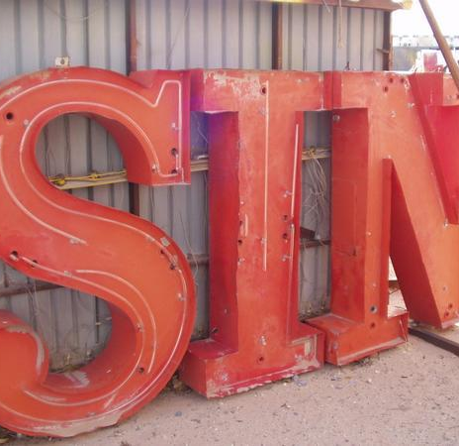
Hiddenness is always the first response to an awareness that I have sinned.
Sin and hiding are inseparable
This Photo by Unknown Author is licensed under CC BY-SA

Slide 9
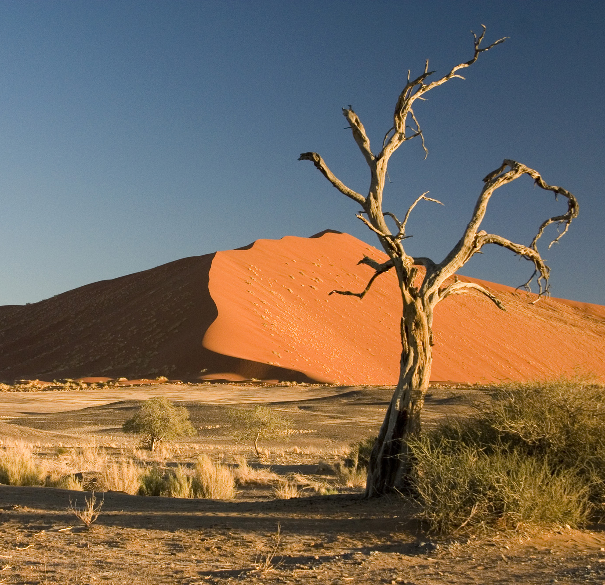
It is in the desert that Jacob battled; and it is in the desert that you do battle with the unruly forces of your nature within and without.
This Photo by Unknown Author is licensed under CC BY-SA

Slide 10
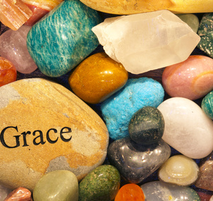
The Desert was a space that provided an opportunity, and even a calling, for divine vision.
You are confronted with another reality, with the presence of a boundless God, whose grace was without any limits at all.
This Photo by Unknown Author is licensed under CC BY-ND

Slide 11
Isaiah 30:15-16
For thus says the Lord God, the Holy One of Israel:
“In returning and rest you shall be saved; In quietness and confidence shall be your strength.” But you would not, ¹⁶ And you said, “No, for we will flee on horses”— Therefore you shall flee! And, “We will ride on swift horses”— Therefore those who pursue you shall be swift!

Slide 12
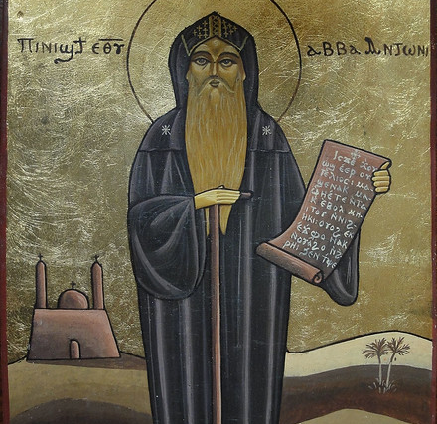
The Desert is an invitation to transfiguration.
Abba Antony also said: “Always have the fear of God before your eyes. Remember Him who gives death and life. Hate the world and all that is in it. Hate all peace that comes from the flesh. Renounce this life, so that you may be alive to God.
This Photo by Unknown Author is licensed under CC BY-NC-ND

Slide 13
Remember what you have promised God, for it will be required of you on the Day of Judgment. Suffer hunger; suffer thirst; suffer nakedness; be watchful and sorrowful; weep and groan in your heart; test yourselves, to see if you are worthy of God; despise the flesh, so that you may preserve your souls.”

Slide 14
It is a place of inner protest, not outward peace!
Living in the desert does not mean living without people; it means living for God.

Slide 15
Hosea 2:14-16
Yet, if you do not have to go to the desert, you do have to go through the desert.
“Therefore, behold, I will allure her, Will bring her into the wilderness, And speak ^{[a]}comfort to her. ¹⁵ I will give her her vineyards from there, And the Valley of Achor as a door of hope; She shall sing there, As in the days of her youth, As in the day when she came up from the land of Egypt.
¹⁶ “And it shall be, in that day,” Says the Lord, “That you will call Me ‘My Husband,’ And no longer call Me ‘My Master,’

Slide 16
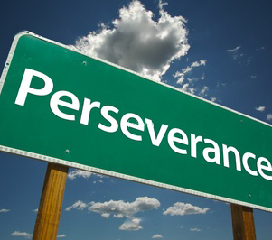
If we go through this experience involuntarily, then it can be both overwhelming and crushing.
If we accept to undergo this experience voluntarily, then it can prove both constructive and liberating.
This Photo by Unknown Author is licensed under CC BY-ND

Slide 17
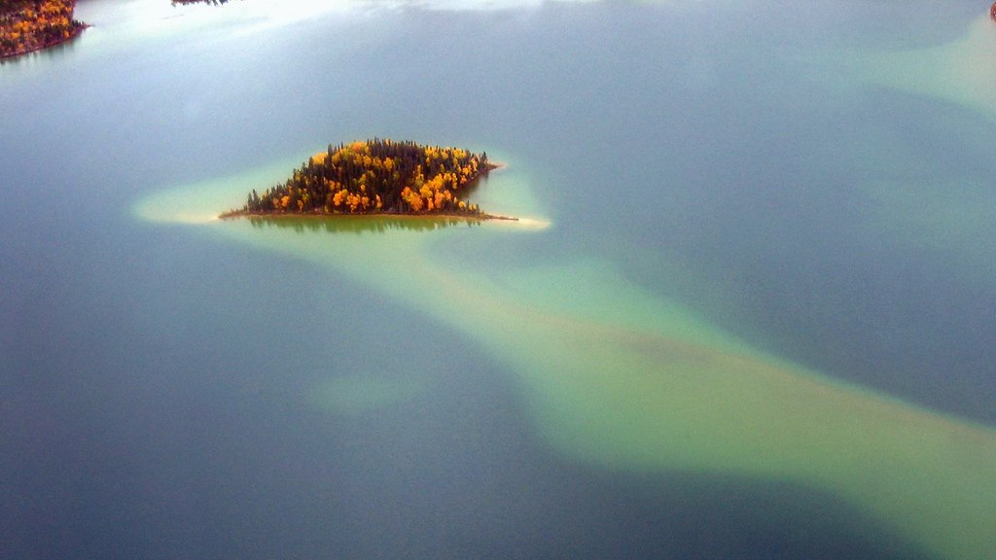
In the cell, you simply stay with yourself; you sit with your emotions; and you shut the door to any intrusion.
A brother came to Scetis to visit Abba Moses and asked him for a word. The old man said to him: “Go, sit in your cell, and your cell will teach you everything.”
This Photo by Unknown Author is licensed under CC BY-SA-NC

Slide 18
The temptation in the spiritual life is to move away from the temptation, to avoid the pain.
Blessed Syncletica said: “If you find yourself in a monastery, do not go to another place. For that will harm you a great deal. Just as the bird that abandons the eggs she was sitting on prevents them from hatching, so the monk or the nun grow cold and their faith dies, when they go from one place to another.”

Slide 19
Abba Antony puts it more bluntly:
Just as fish die if they stay too long out of water, so the monks who loiter outside their cell or pass their time with worldly people lose the intensity of inner peace.
So like fish going toward the sea, we must hurry to reach our cell, for fear that if we delay outside, we shall lose our interior watchfulness.

Slide 20
Abba Ammonas said: “Go, sit in your cell, and engrave it on your heart.”
The boundaries of our cell are gradually expanded to include every moment in our life and every detail in our world.
This Photo by Unknown Author is licensed under CC BY-NC-ND

Slide 21
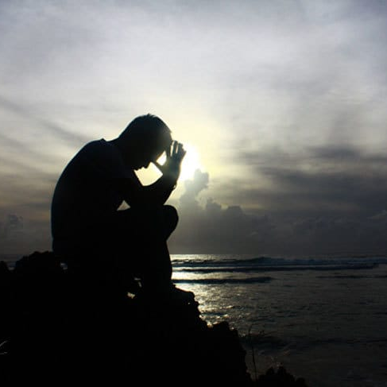
The cell becomes the place where we encounter God, the place where God is.
“Evil thoughts and demons disappear through patience,” claimed Abba Poemen. Patience is something you pray for fervently. Once gained, however, it can even heal the sick!
This Photo by Unknown Author is licensed under CC BY-SA

