Slide 1
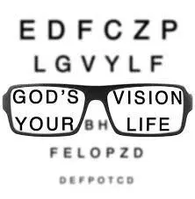
20/20 vision
Discover God’s Vision for Your life

Slide 2
Proverbs 29:18
Where there is no vision, the people are unrestrained, but happy is he who keeps the law

Slide 3
Ecclesiastes 2:11
“Yet when I surveyed all that my hands had done and what I had toiled to achieve, everything was meaningless, a chasing after the wind; nothing was gained under the sun.”

Slide 4
Any personal vision apart from God’s will for our lives is incomplete.

Slide 5
There is no story

Slide 6
Make up You own story

Slide 7
2 Timothy 4:3-4
“For the time will come when they will not endure sound doctrine, but according to their own desires, because they have itching ears, they will heap up for themselves teachers; ⁴ and they will turn their ears away from the truth, and be turned aside to fables.”

Slide 8
Become part of God’s story

Slide 9
What is God’s Vision for Our Lives?
Knowing Jesus’ vision for His people means that we respond with a personal vision for our lives that is consistent with God’s plan

Slide 10
There was a certain man in Caesarea called Cornelius, a centurion of what was called the Italian ^{[a]}Regiment, ² a devout man and one who feared God with all his household, who gave ^{[b]}alms generously to the people, and prayed to God always. ³ About ^{[c]}the ninth hour of the day he saw clearly in a vision an angel of God coming in and saying to him, “Cornelius!”
⁴ And when he observed him, he was afraid, and said, “What is it, lord?”

Slide 11
So he said to him, “Your prayers and your alms have come up for a memorial before God. ⁵ Now send men to Joppa, and send for Simon whose surname is Peter. ⁶ He is lodging with Simon, a tanner, whose house is by the sea. He^{[d]} will tell you what you must do.” ⁷ And when the angel who spoke to him had departed, Cornelius called two of his household servants and a devout soldier from among those who waited on him continually. ⁸ So when he had explained all these things to them, he sent them to Joppa.
The next day, as they went on their journey and drew near the city, Peter went up on the housetop to pray, about ^{[e]}the sixth hour. ¹⁰ Then he became very hungry and wanted to eat; but while they made ready, he fell into a trance ¹¹ and saw heaven opened and an object like a great sheet bound at the four corners, descending to him and let down to the earth. ¹² In it were all kinds of four-footed animals of the earth, wild beasts, creeping things, and birds of the air. ¹³ And a voice came to him, “Rise, Peter; kill and eat.”

Slide 12
¹⁴ But Peter said, “Not so, Lord! For I have never eaten anything common or unclean.”
¹⁵ And a voice spoke to him again the second time, “What God has^{[f]}cleansed you must not call common.” ¹⁶ This was done three times. And the object was taken up into heaven again.
Now while Peter ^{[g]}wondered within himself what this vision which he had seen meant, behold, the men who had been sent from Cornelius had made inquiry for Simon’s house, and stood before the gate. ¹⁸ And they called and asked whether Simon, whose surname was Peter, was lodging there.

Slide 13
¹⁹ While Peter thought about the vision, the Spirit said to him, “Behold, three men are seeking you. ²⁰ Arise therefore, go down and go with them, doubting nothing; for I have sent them.”
²¹ Then Peter went down to the men ^{[h]}who had been sent to him from Cornelius, and said, “Yes, I am he whom you seek. For what reason have you come?”
²² And they said, “Cornelius the centurion, a just man, one who fears God and has a good reputation among all the nation of the Jews, was divinely instructed by a holy angel to summon you to his house, and to hear words from you.” ²³ Then he invited them in and lodged them.
On the next day Peter went away with them, and some brethren from Joppa accompanied him.

Slide 14
God’s vision opens unknown territory

Slide 15
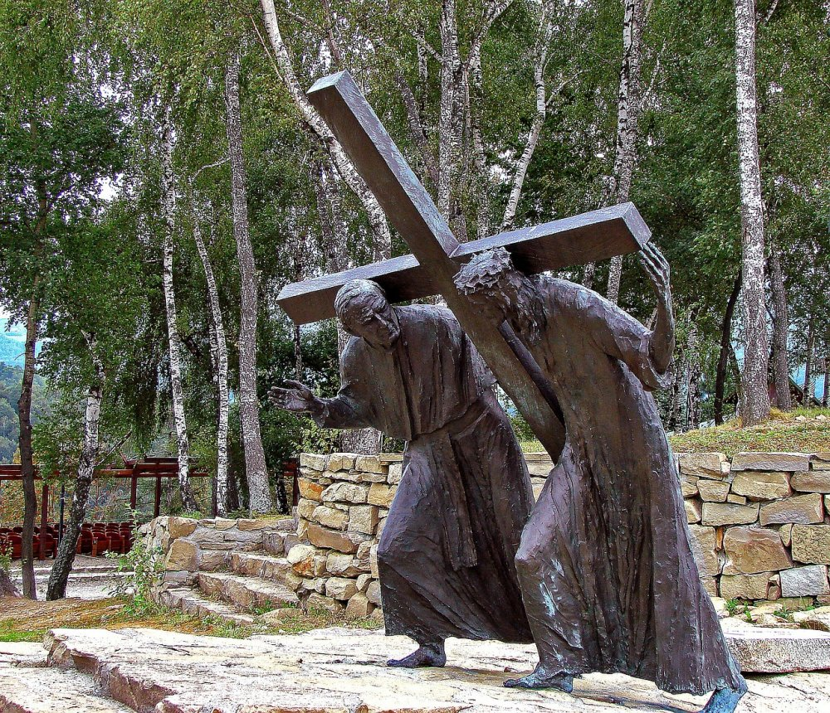
God’s call for your life is a burden- it is His burden!
And He is inviting you to share in that burden

Slide 16
We Receive God’s vision
by entering his presence consistently and seeing where God is working

