Slide 1
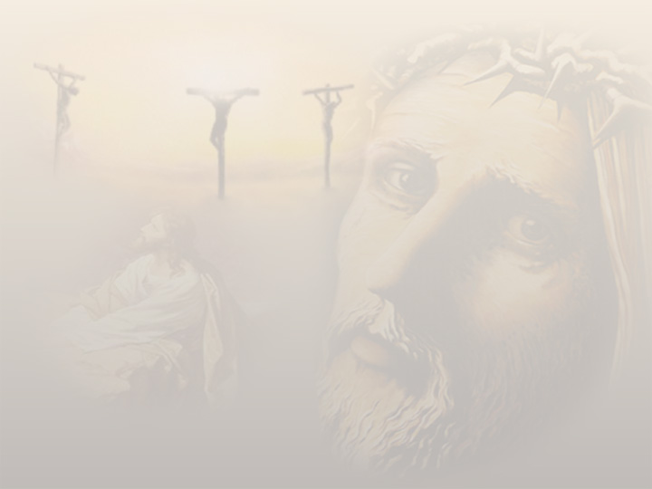
Eve of Tuesday
March 29, 2010

Slide 2
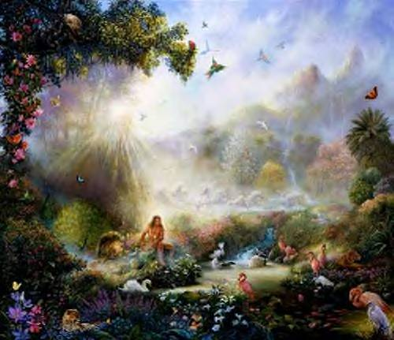

Slide 3
The garden/vineyard is my heart

Slide 4
What’s Adam’s role in this?
“Then the LORD God took the man and put him in the garden of Eden to tend and keep it.” Genesis 2:15

Slide 5
Genesis 2:25-3:13
²⁵ And they were both naked, the man and his wife, and were not ashamed.
¹ Now the serpent was more cunning than any beast of the field which the LORD God had made. And he said to the woman, “Has God indeed said, ‘You shall not eat of every tree of the garden’?”
² And the woman said to the serpent, “We may eat the fruit of the trees of the garden; ³ but of the fruit of the tree which is in the midst of the garden, God has said, ‘You shall not eat it, nor shall you touch it, lest you die.’”

Slide 6
Genesis 2:25-3:13
⁴ Then the serpent said to the woman, “You will not surely die. ⁵ For God knows that in the day you eat of it your eyes will be opened, and you will be like God, knowing good and evil.”
⁶ So when the woman saw that the tree was good for food, that it was pleasant to the eyes, and a tree desirable to make one wise, she took of its fruit and ate. She also gave to her husband with her, and he ate.

Slide 7
Genesis 2:25-3:13
⁷ Then the eyes of both of them were opened, and they knew that they were naked; and they sewed fig leaves together and made themselves coverings.

Slide 8
Genesis 2:25-3:13
⁸ And they heard the sound of the LORD God walking in the garden in the cool of the day, and Adam and his wife hid themselves from the presence of the LORD God among the trees of the garden. ⁹ Then the LORD God called to Adam and said to him, “Where are you?”
¹⁰ So he said, “I heard Your voice in the garden, and I was afraid because I was naked; and I hid myself.”

Slide 9
Genesis 2:25-3:13
¹¹ And He said, “Who told you that you were naked? Have you eaten from the tree of which I commanded you that you should not eat?”
¹³ …“What is this you have done?”…

Slide 10
The defining characteristic
of Paradise was NAKEDNESS
“And they were both naked, the man and his wife, and were not ashamed.” Genesis 2:25

Slide 11
The defining characteristic
of Paradise was NAKEDNESS
“And they were both naked, the man and his wife, and were not ashamed.” Genesis 2:25
“bare of any covering, destitute, defenseless, exposed, vulnerable, HELPLESS”

Slide 12
The defining characteristic
of Paradise was NAKEDNESS
“Cursed is the ground for your sake; in toil you shall eat of it all the days of your life. Both thorns and thistles it shall bring forth for you, and you shall eat the herb of the field.” Genesis 3:17-18

Slide 13
Our usual response to problems in the vineyard is HIDE NAKEDNESS

Slide 14
The Solution?

Slide 15
The Solution?
Reveal my nakedness to God

Slide 16
The Solution?
Reveal my nakedness to God
“And there is no creature hidden from His sight, but all things are naked and open to the eyes of Him to whom we must give account.” Hebrews 4:13

Slide 17
GOD HATES FIG LEAVES!
“So then, because you are lukewarm, and neither cold nor hot, I will vomit you out of My mouth. Because you say, ‘I am rich, have become wealthy, and have need of nothing’—and do not know that you are wretched, miserable, poor, blind, and naked” Revelation 3:16-17

Slide 18
Good News
“Also for Adam and his wife the LORD God made tunics of skin, and clothed them.” Genesis 3:21

Slide 19
Good News
“Also for Adam and his wife the LORD God made tunics of skin, and clothed them.” Genesis 3:21
Blood of a sacrifice
“He went up on the cross naked to clothe us with the cloak of His righteousness”

Slide 20
Gospel of 1st Hour of Monday
“Now in the morning, as they passed by, they saw the fig tree dried up from the roots. And Peter, remembering, said to Him, “Rabbi, look! The fig tree which You cursed has withered away.” So Jesus answered and said to them, “Have faith in God.” Mark 11:20-22

