Slide 1
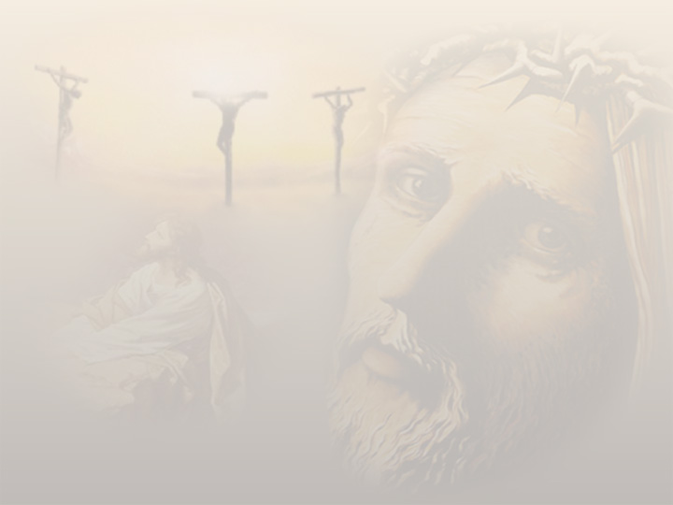
Hosanna Indeed!
Palm Sunday
March 28, 2010

Slide 2
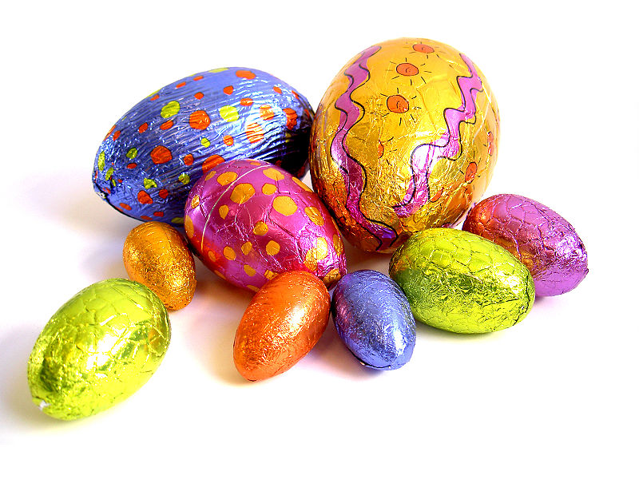

Slide 3
NEW LIFE!

Slide 4
NEW LIFE!
“Therefore we were buried with Him through baptism into death, that just as Christ was raised from the dead by the glory of the Father, even so we also should walk in newness of life.” Romans 6:4

Slide 5
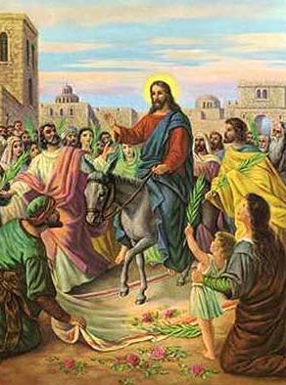
I need a Savior
Hosanna to the King of Israel

Slide 6
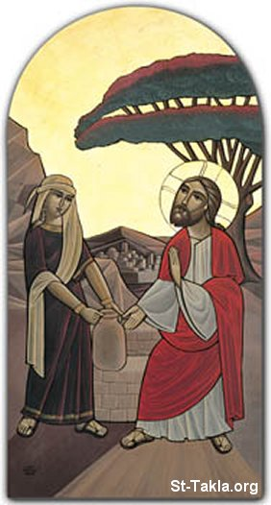
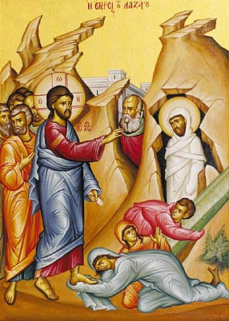
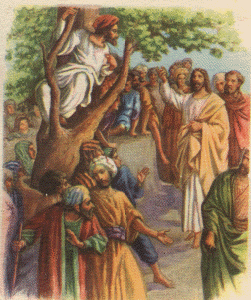
Coming to Give New Life

Slide 7
“For God so loved the world that He gave His only begotten Son, that whoever believes in Him should not perish but have everlasting life.” John 3:16

