Slide 1
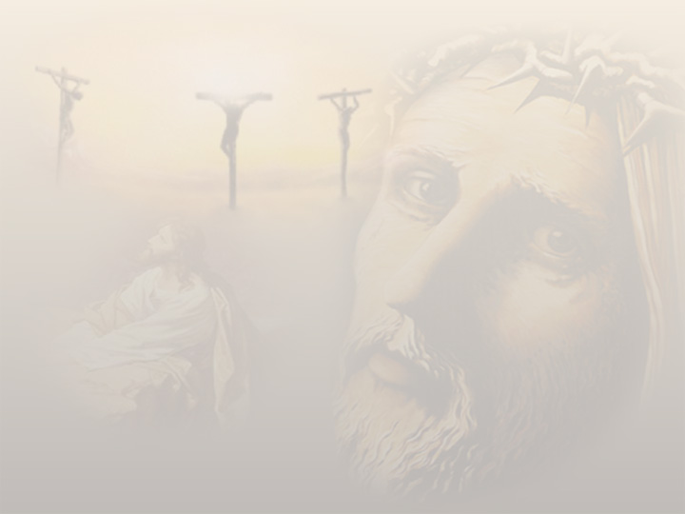
Good Friday
April 2, 2010

Slide 2
“He was wounded for our transgressions, He was bruised for our iniquities; the chastisement for our peace was upon Him, and by His stripes we are healed…the LORD has laid on Him the iniquity of us all… it pleased the LORD to bruise Him; He has put Him to grief.” Isaiah 53:5-6, 10

Slide 3
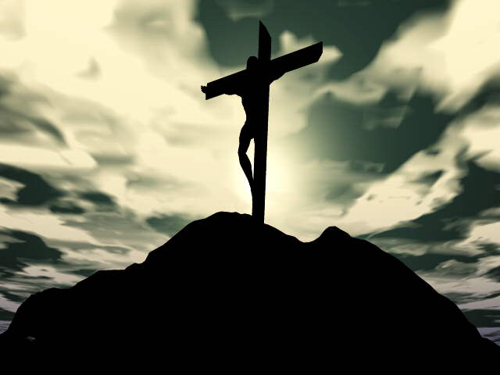
This Love Deserves a Response

Slide 4
This Love Deserves a Response
“and He died for all, that those who live should live no longer for themselves, but for Him who died for them and rose again.” 2 Corinthians 5:15

Slide 5
My Response?

Slide 6
My Response?
DEATH/MURDER

Slide 7
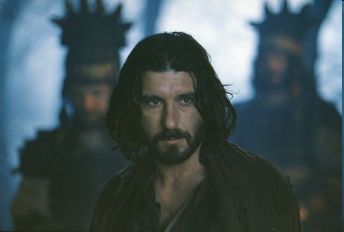
My Response?
DEATH/MURDER

Slide 8
Judas is inside, not outside
“His words were softer than oil, yet they were drawn swords.” Psalm 55:20

Slide 9
Judas is inside, not outside
Lack of trust

Slide 10
Judas is inside, not outside
Lack of trust
Self-reliance

Slide 11
Judas must die!
“Let his dwelling place be desolate, and let no one live in it’; and, ‘Let another take his office.’” Acts 1:20

