Slide 1
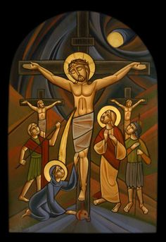
Preparation For Holy Week

Slide 2
Plan for Growth
1) Go to as many services as you can.
2) Intensify your fasting.
3) Create silence.
4) Create prayer.
5) Be still.
6) Always be with Christ
7) Read a Gospel.
8) Seek forgiveness and healing.
9) Call someone who is sick or lonely.

