Slide 1
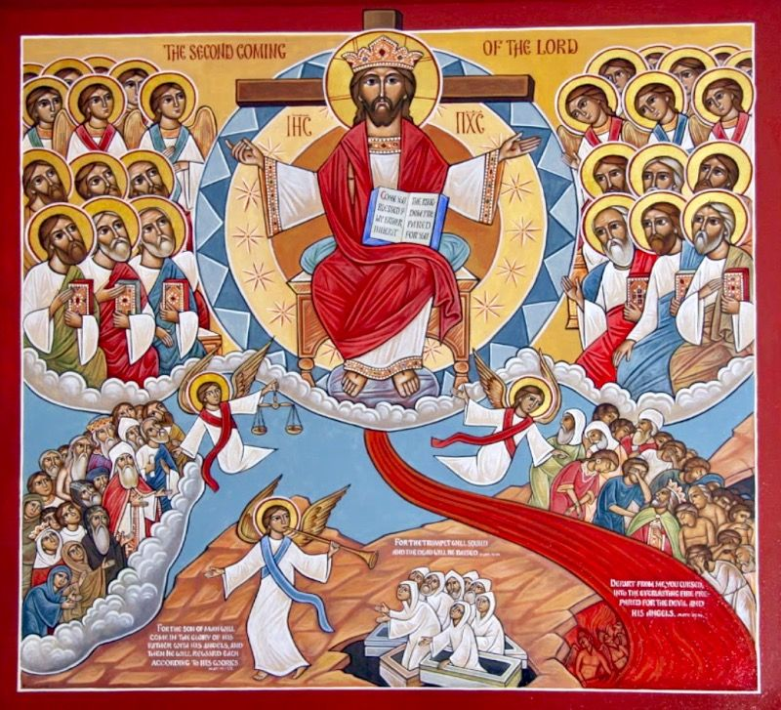
The two sides of the Parrousia
4th Sunday of Messri

Slide 2
for the elect’s sake
²² And unless those days were shortened, no flesh would be saved; but for the elect’s sake those days will be shortened. Matt 24:22

Slide 3
the love of many will grow cold
And because lawlessness will abound, the love of many will grow cold. Matt 24:12

Slide 4
No condemnation
There is therefore now no condemnation to those who are in Christ Jesus, who do not walk according to the flesh, but according to the Spirit. Rom 8:1

Slide 5
resulting in justification of life
Therefore, as through one man’s offense judgment came to all men, resulting in condemnation, even so through one Man’s righteous act the free gift came to all men, resulting in justification of life. Rom 5:18

Slide 6
Commentary of Matthew 25 St Augustine
But I wish you to be without anxiety. He who is without anxiety waits without fear until his Lord comes. For what sort of love of Christ is it to fear his coming? Brothers, do we not have to blush for shame? We love him, yet we fear his coming. Are we really certain that we love him? Or do we love our sins more?

